Slide 1
STEMI
Presented by Mahsa Abdollahi
General Cardiologist

Slide 2
STEMI remains a major public health problem in the industrialized world and is on the rise in developing countries.
The rate of MI rises sharply in both men and women with increasing age, and racial differences exist, with MI occurring more frequently in black men and women compared to white, regardless of age.
Rates of appropriate initiation of reperfusion therapy vary widely, with up to 30% of patients with STEMI who are eligible to receive reperfusion therapy not receiving this lifesaving treatment.

Slide 3
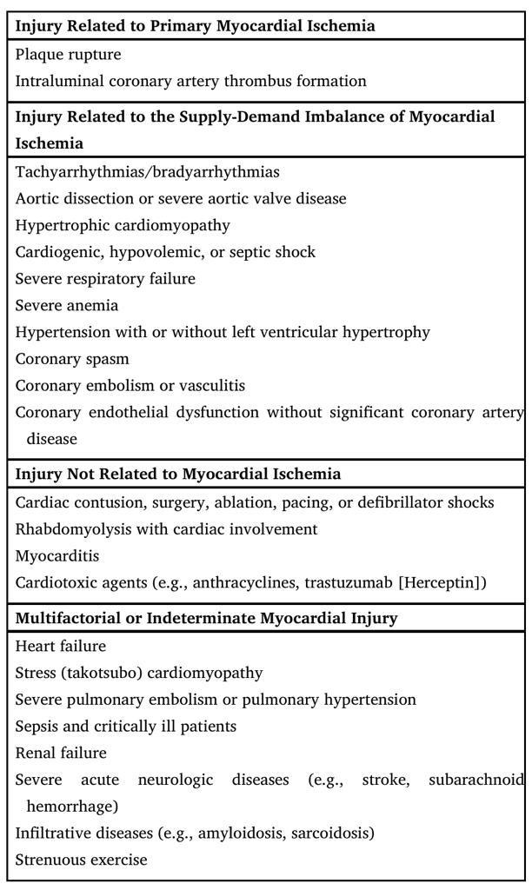
Causes of Myocardial Injury

Slide 4
Patients with new onset or worsening ischemic symptoms should be considered as having an acute coronary syndrome (ACS):
Unstable Angina
Non–ST-segment elevation MI (NSTEMI)
ST-segment elevation MI (STEMI).
The principal diagnostic tool for patients with suspected ACS is the 12-lead electrocardiogram (ECG).

Slide 5
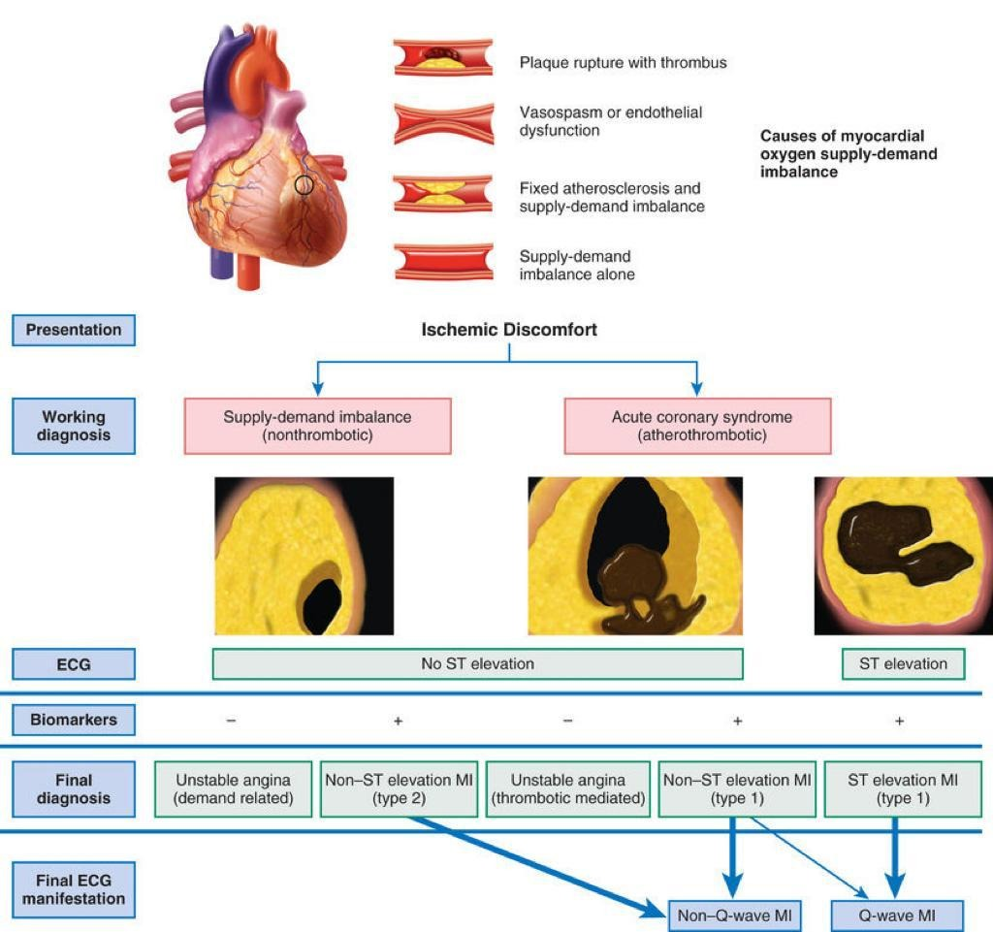

Slide 6
Universal Myocardial Infarction (MI) Classification of Type
Type 1: Spontaneous Myocardial Infarction:
Related to atherosclerotic plaque rupture, ulceration, fissuring, erosion, or dissection with resulting intraluminal thrombus in one or more of the coronary arteries that leads to decreased myocardial blood flow or distal platelet emboli with ensuing myocyte necrosis.
The patient may have underlying severe CAD but on occasion nonobstructive or no CAD.

Slide 7
Type 2: Myocardial Infarction Secondary to Ischemic ImbalanceIn
cases of myocardial injury with necrosis in which a condition other than CAD contributes to an imbalance between myocardial oxygen supply and/or demand
(e.g., coronary endothelial dysfunction, coronary artery spasm, coronary embolism, tachy/bradyarrhythmias, anemia, respiratory failure, hypotension, hypertension ± left ventricular hypertrophy).

Slide 8
Type 3: Myocardial Infarction Resulting in Death When Biomarker Values Are Unavailable
Cardiac death with symptoms suggestive of myocardial ischemia and presumed new ischemic changes on the ECG or new LBBB, but death occurring before blood samples could be obtained, before cardiac biomarkers could rise, or in rare cases, when cardiac biomarkers were not collected.

Slide 9
Type 4a: Myocardial Infarction Related to PCI
MI associated with PCI is arbitrarily defined by elevation of cTn values to >5 × the 99th percentile URL in patients with normal baseline values (≤99th percentile URL) or a rise in cTn values >20% if the baseline values are elevated and are stable or falling. In addition, either :
(1) symptoms suggestive of myocardial ischemia,
(2) new ischemic changes on the ECG or new LBBB,
(3) angiographic loss of patency of a major coronary artery or a side branch or persistent slow flow or no flow or embolization, or
(4) imaging demonstration of new loss of viable myocardium or new regional wall motion abnormality is required.

Slide 10
Type 4b: Myocardial Infarction Related to Stent Thrombosis
MI associated with stent thrombosis is detected by coronary angiography or autopsy in the setting of myocardial ischemia and with a rise and/or fall in cardiac biomarkers values with at least one value above the 99th percentile URL.

Slide 11
Type 5: Myocardial Infarction Related to CABG
MI associated with CABG is arbitrarily defined by elevation of cardiac biomarker values to >10 × the 99th percentile URL in patients with normal baseline cTn values (<99th percentile URL). In addition, either:
(1) new pathologic Q waves or new LBBB,
(2) angiographically documented new graft or new native coronary artery occlusion, or
(3) imaging evidence of new loss of viable myocardium or new regional wall motion abnormality is required.

Slide 12
When acute coronary atherothrombosis occurs, the resulting intracoronary thrombus may:
obstruct partially, which generally leads to myocardial ischemia in the absence of ST elevation, or
occlude completely and cause transmural myocardial ischemia and STEMI.
Before the fibrinolytic era, clinicians typically divided patients with MI into:
Q wave-MI ( Transmural MI)
Non–Q wave MI (Subendocardial MI) Contemporary studies using
CMR indicate that the development of a Q wave on the ECG depends more on the size of the infarct than on the depth of mural involvement. Thus the use of ACS is the more appropriate.

Slide 13
Further classification of ACS patients:
ST-segment elevation (STEMI): are candidates for reperfusion therapy (either pharmacologic or catheter based) to restore flow in the occluded epicardial infarct-related artery
Non–ST-segment elevation (Non-STEMI) : elevation are not candidates for pharmacologic reperfusion but should receive anti-ischemic and antithrombotic therapy, followed in most cases by PCI.
Angiographic studies performed in the earliest hours of STEMI find an approximately 90% incidence of total occlusion of the infarct-related vessel. Spontaneous fibrinolysis of the thrombotic occlusion can occur in the period following the onset of MI. Pharmacologic fibrinolysis and PCI markedly increase the proportion of patients with a patent infarct-related artery early after STEMI.

Slide 14
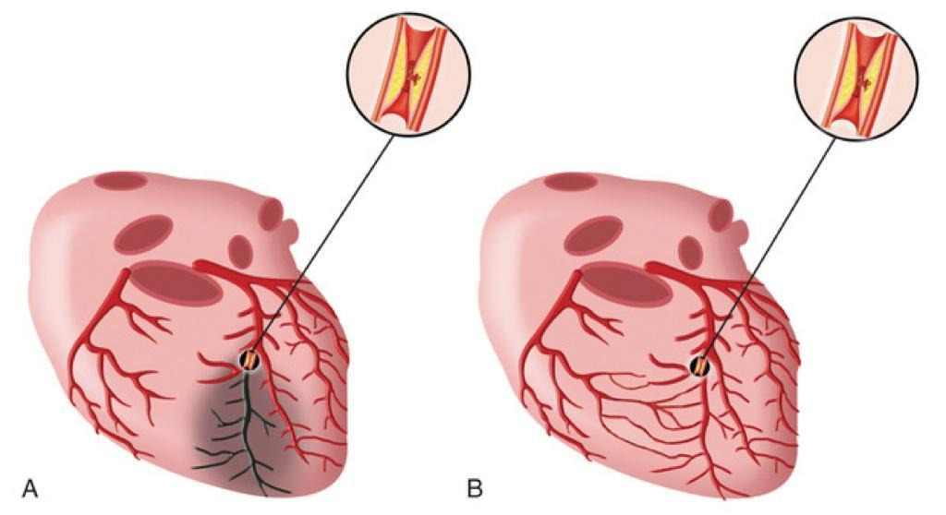

Slide 15
The cellular effects of ischemia commence within seconds of the onset of hypoxia with the loss of adenosine triphosphate (ATP) production.
Myocardial relaxation-contraction is compromised, and irreversible cell injury begins within as early as 20 minutes.
Necrosis is usually complete in 6 hours unless reperfusion occurs or an extensive collateral circulation is present.

Slide 16
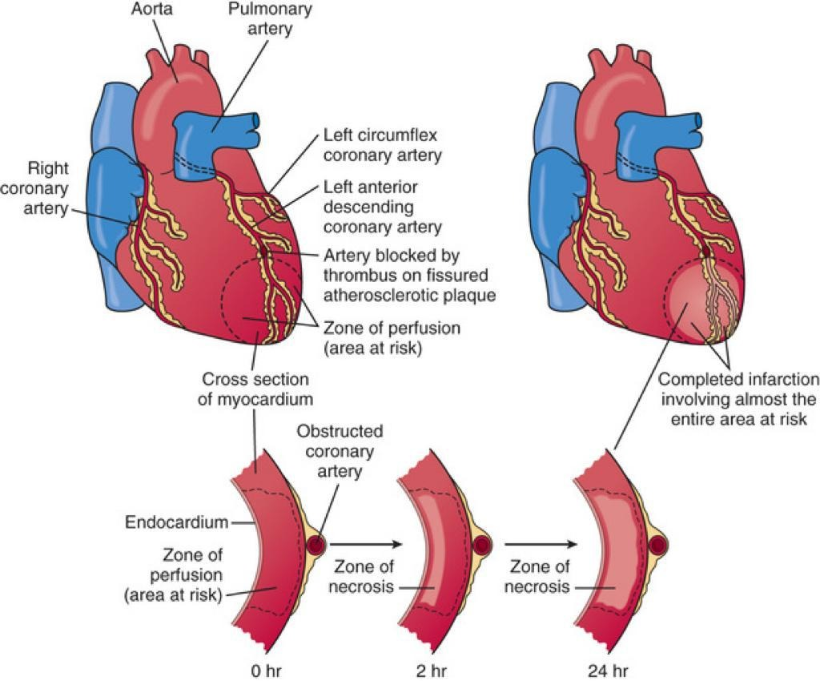

Slide 17
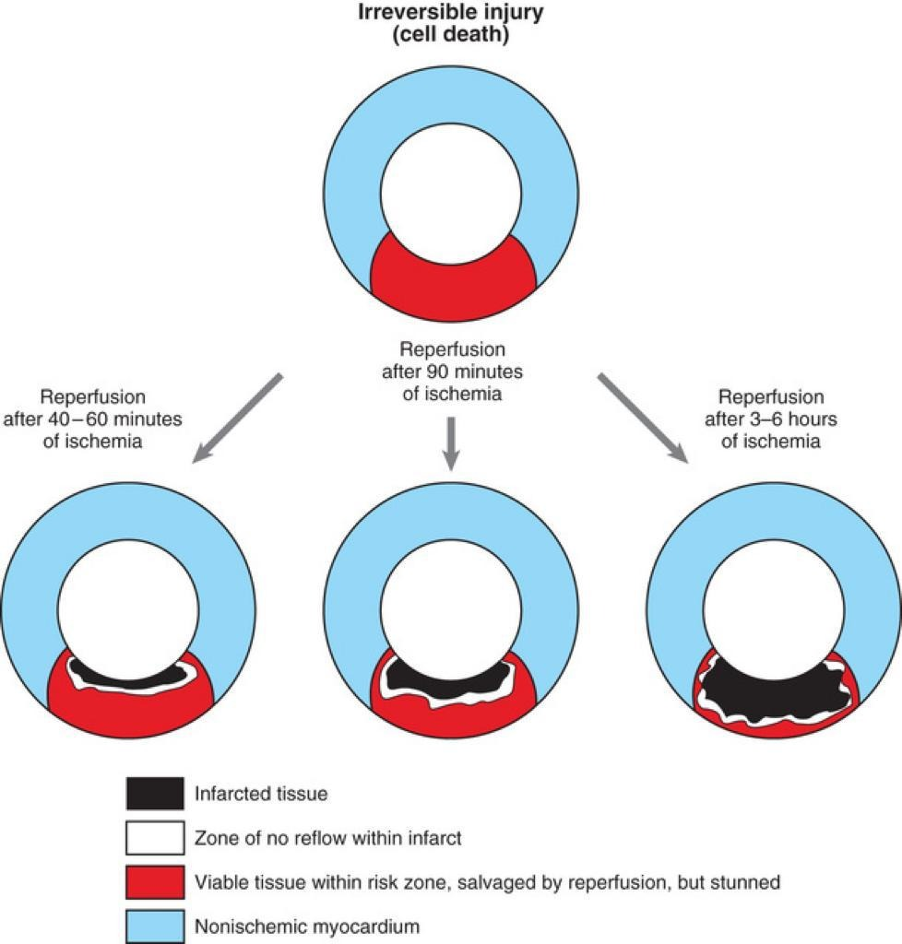

Slide 18
Right Ventricular Infarction
Approximately 30% to 50% of patients with inferior infarction have some involvement of the right ventricle.
RV infarction almost invariably develops in association with a large infarction of the adjacent septum and inferior LV wall.
Isolated infarction of the right ventricle is seen in just 3% to 5% of autopsy-proven cases of MI.
RV infarction occurs less often than would be anticipated from the frequency of atherosclerotic lesions involving the RCA.

Slide 19
RV- MI
The classic presentation of an RV infarct is hypotension, clear lung fields, and elevated jugular venous pressures.
Acute management of RV infarction complicated by cardiogenic shock includes:
judicious volume replacement
early revascularization
maintenance of atrioventricular synchrony
in refractory cases, mechanical circulatory support
In contrast to the left ventricle, the right ventricle can sustain long periods of ischemia but still demonstrate excellent recovery of contractile function after reperfusion.

Slide 20
Atrial Infarction
Infarction of the atria occurs in up to 10% of patients with STEMI if PR-segment displacement is used as the criterion.
Although isolated atrial infarction is observed in less than 5% of patients with STEMI at autopsy, it often occurs in conjunction with ventricular infarction and can cause rupture of the atrial wall.

Slide 21
Atrial Infarction
This type of infarction is more common on the right than the left side, occurs more frequently in the atrial appendages than in the lateral or posterior walls of the atrium.
Can result in thrombus formation.
Atrial arrhythmias frequently accompany atrial infarction.
Reduced secretion of atrial natriuretic peptide (ANP) may ensue and lead to a low–cardiac output syndrome when RV infarction coexists.

Slide 22
Collateral Circulation in Acute MI
Patients with occlusive CAD frequently have a particularly well-developed coronary collateral circulation, especially:
Those with reduction of the luminal cross-sectional area by more than 75% in one or more major vessels;
Patients with chronic hypoxia, as occurs in severe anemia, COPD, and cyanotic congenital heart disease;
Those with LV hypertrophy

Slide 23
Collateral Circulation in Acute MI
The magnitude of coronary collateral flow is a principal determinant of infarct size.
Indeed, patients with abundant collateral vessels may have totally occluded coronary arteries without evidence of infarction in the distribution of that artery; thus survival of myocardium distal to such occlusions depends largely on collateral blood flow.
Even if the collateral perfusion existing at the time of coronary occlusion does not prevent infarction, it may still exert a beneficial effect by preventing the formation of LV aneurysms.

Slide 24
Collateral Circulation in Acute MI
The presence of a high-grade stenosis (90%), possibly with periods of intermittent total occlusion, probably permits the development of collateral vessels that remain only as potential conduits until a total occlusion occurs or recurs. Total occlusion then brings these channels into full operation.
Patients with angiographic evidence of collateral formation have improved angiographic and clinical outcomes after MI.

Slide 25
Nonatherosclerotic Causes of Acute Myocardial Infarction
Numerous pathologic processes other than atherosclerosis can involve the coronary arteries and result in STEMI. For example,
Embolization into a coronary artery: infective endocarditis and nonbacterial thrombotic endocarditis, mural thrombi, prosthetic valves, neoplasms, air introduced at cardiac surgery, and calcium deposits from manipulation of calcified valves at surgery.
In situ thrombosis of coronary arteries can occur secondary to chest wall trauma or hypercoagulable states.Spontaneous coronary artery dissection (SCAD), once thought to be a relatively rare event, is identified more frequently now with greater utilization of intracoronary imaging and may account for 10% to 30% of MIs in women younger than 50. Initial triage and evaluation of patients with suspected SCAD should follow standard ACS algorithms. A clear dissection flap and thrombosis may be visible at angiography, but often there is only an intramural hematoma, which can be mistaken for vasospasm or an atherosclerotic plaque unless intracoronary imaging is used. Revascularization strategies for SCAD diverge from standard ACS recommendations. Conservative management with oral and intravenous (IV) antithrombotic therapy alone is recommended if coronary flow is preserved because of high rates of PCI-related complications. Revascularization with PCI or coronary artery bypass grafting (CABG) should be considered for occlusive lesions, recognizing a higher risk of complications.33Rarer causes include syphilitic aortitis, which can produce marked narrowing or occlusion of one or both coronary ostia, whereas Takayasu arteritis can result in obstruction of the coronary arteries. Necrotizing arteritis, polyarteritis nodosa, mucocutaneous lymph node syndrome (Kawasaki disease), systemic lupus erythematosus (see Chapter 94), and giant cell arteritis can cause coronary occlusion. Therapeutic levels of mediastinal radiation can result in coronary arteriosclerosis34 with subsequent infarction. MI can also result from coronary arterial involvement in patients with amyloidosis (see Chapter 77), Hurler syndrome, pseudoxanthoma elasticum, and homocystinuria. Cocaine can cause MI in patients with normal coronary arteries, preexisting MI, documented coronary artery disease, or coronary artery spasm (see Chapter 80).

Slide 26
Myocardial Infarction with Nonobstructive Coronary Arteries (MINOCA)
MINOCA is defined as:
Evidence of MI (positive cardiac biomarker and clinical evidence of infarction)
Angiographically normal or near-normal coronary arteries (the absence of obstructive CAD on angiography, i.e. no coronary artery stenosis ≥50%, in any potential infarct-related artery)
No other explanation for the presentation

Slide 27
Coronary artery spasm, plaque erosion or rupture, and coronary dissection are common MINOCA etiologies affecting the epicardial arteries, as are plaque erosion and plaque rupture not discerned by standard angiography.
Two most common myocardial or microvascular mimickers of MI are acute myocarditis , acute stress (takotsubo) cardiomyopathy.

Slide 28
MINOCA
Compared to patients with atherosclerotic-mediated MI, patients with MINOCA tend to be young and more often females, with relatively few coronary risk factors except a history of cigarette smoking.
One third (1/3) of patients with MINOCA present with STEMI.
Usually, they have no history of angina pectoris before the infarction.
These patients do not generally have a prodrome before infarction, but the clinical, laboratory, and electrocardiographic features of STEMI otherwise resemble those present in the overwhelming majority of patients with STEMI, who have classic obstructive atherosclerotic CAD.
Approximately half (50%)of patients with MINOCA have smooth vessels on angiography, whereas the other half has some nonobstructive irregularities that may predispose them to vasospasm or plaque erosions.

Slide 29
MINOCA
Additional causes MI in the setting of normal-appearing coronary arteries include:
(1) coronary emboli, perhaps from a small mural thrombus, prolapsed mitral valve, or myxoma;
(2) CAD in vessels too small to be visualized on coronary arteriography or coronary arterial thrombosis with subsequent recanalization;
(3) a hematologic disorder (e.g., polycythemia vera, cyanotic heart disease with polycythemia, sickle cell anemia, disseminated intravascular coagulation, thrombocytosis, thrombotic thrombocytopenic purpura) causing in situ thrombosis in the presence of normal coronary arteries;
(4) augmented oxygen demand (e.g., thyrotoxicosis, amphetamine use);
(5) hypotension secondary to sepsis, blood loss, or pharmacologic agents;
(6) anatomic variations, such as anomalous origin of a coronary artery, coronary arteriovenous fistula, or a myocardial bridge.

Slide 30
MINOCA
In general, patients who have survived STEMI without evidence of significant CAD have a better long-term outlook than those with atherosclerotic-mediated STEMI.
In-hospital mortality is approximately 60% lower, and 1-year mortality, 40% lower.
However, the subsequent risk for patients presenting with MINOCA is largely based on the underlying etiology and comorbidities.
Cardiac magnetic resonance imaging (CMR)is recommended to exclude myocarditis in patients without clear cause of MINOCA.

Slide 31
Stress (Takotsubo) Cardiomyopathy
Acute stress cardiomyopathy, also termed transient LV apical ballooning syndrome or takotsubo cardiomyopathy, typically involves transient wall motion abnormalities involving the LV apex and midventricle , although other patterns have been reported, including “reverse” takotsubo pattern.
This syndrome occurs in the absence of obstructive epicardial CAD and can mimic STEMI.
Typically, an episode of physical or psychological stress precedes the development of takotsubo cardiomyopathy; although some cases lack an evident precipitant.
should not preclude urgent catheterization to exclude acute thrombotic lesions.38

Slide 32
Stress (Takotsubo) Cardiomyopathy
More than half of patients presenting with takotsubo cardiomyopathy have an active or history of a neurologic or psychiatric disorder, potentially linking neurologic-mediated vasoconstriction.
Initial ECGs demonstrate substantial and often diffuse ST-segment elevation, prompting, when coupled with the typical (frequently severe) chest discomfort, the appropriate immediate referral for coronary angiography.

Slide 33
Stress (Takotsubo) Cardiomyopathy
The etiology of stress-induced cardiomyopathy is not clear, but neurally activated or circulating catecholamine-mediated microvascular dysfunction, as well as myocardial stunning and injury, play important roles.
Most patients with takotsubo cardiomyopathy will experience rapid recovery of ventricular function, although more than 20% of patients do suffer in-hospital complications, including heart failure, arrhythmias, and death, and at rates similar to patients with ACS.

Slide 34
Left Ventricular Function
Systolic Function
On interruption of antegrade flow in an epicardial coronary artery, the zone of myocardium supplied by that vessel immediately loses its ability to shorten and perform contractile work.
Patients with STEMI may also have reduced myocardial contractile function in noninfarcted zones. This finding may result from previous obstruction of the coronary artery supplying the noninfarcted region of the ventricle and loss of collaterals from the freshly occluded infarct-related vessel, a condition termed ischemia at a distance.
Conversely, the development of collaterals before STEMI occurs may allow greater preservation of regional systolic function in an area of distribution of the occluded artery and improvement in the LV ejection fraction (EF) early after infarction.

Slide 35
When the abnormally contracting segment exceeds 15% of the myocardium, the EF may decline, and LV end-diastolic pressure and volume may increase.
The risk for the development of physical signs and symptoms of LV failure also increases in proportion to increasing areas of abnormal LV wall motion.
Clinical heart failure accompanies areas of abnormal contraction exceeding 25%.
Loss of more than 40% of the LV myocardium usually leads to cardiogenic shock, often fatal.

Slide 36
Clinical Features
Predisposing Factors
Up to one third (1/3) of patients with STEMI have an identifiable precipitating trigger or prodromal symptoms.
Unusually heavy exercise (particularly in fatigued or habitually inactive patients), emotional stress, and acute illness are the most frequent triggers.
Such infarctions could result from marked increases in myocardial oxygen consumption in the presence of severe coronary arterial narrowing (a type 2 MI), or the acute hemodynamic stress on a fragile plaque from a catecholamine or blood pressure surge.

Slide 37
Clinical Features
Accelerating angina and rest angina, two patterns of unstable angina, may culminate in STEMI.
Noncardiac surgical procedures may also precede STEMI.
Reduced myocardial perfusion secondary to hypotension (e.g., hemorrhagic or septic shock) and the increased myocardial oxygen demands caused by aortic stenosis, fever, tachycardia, and agitation can also contribute to myocardial necrosis.
Other factors reported to predispose to STEMI include respiratory infections, hypoxemia from any cause, pulmonary embolism, hypoglycemia, administration of ergot preparations, cocaine use, sympathomimetics, serum sickness, allergy, and rarely, wasp stings.
In patients with Prinzmetal angina , STEMI may develop in the territory of the coronary artery that undergoes spasm.

Slide 38
Clinical Features
Circadian Periodicity
The time of onset of STEMI has a pronounced circadian periodicity, with the peak incidence of events occurring in the morning.
Circadian rhythms affect many physiologic and biochemical variables; plasma catecholamines and cortisol and platelet aggregability increase in the early-morning hours.
Patients receiving a beta-blocking agent or aspirin do not exhibit this characteristic circadian peak before the development of STEMI, consistent with precipitation by sympathetic stimuli or platelet activation.
The concept of “triggering” a STEMI is complex and can involve the superimposition of multiple factors, such as the time of day, season, and the stress of natural disasters.

Slide 39
Clinical Features
Prodromal Symptoms
The patient's history remains crucial to establishing a diagnosis of STEMI.
Chest discomfort resembling classic angina pectoris usually characterizes the prodrome, but it occurs at rest or with less activity than usual.
A feeling of general malaise or frank exhaustion frequently accompanies other symptoms preceding STEMI.

Slide 40
Clinical Features
Nature of the Pain
Pain in patients with STEMI varies in intensity; in most patients it is severe and in some instances is intolerable.
The pain is prolonged—it generally lasts for more than 30 minutes and frequently for several hours if there is no reperfusion.
The patient usually describes the discomfort as constricting, crushing, oppressing, or compressing and often complains of a sensation of a heavy weight or a squeezing in the chest.
Although patients typically describe the discomfort as a choking, viselike, or heavy pain, it can also be characterized as a stabbing, knifelike, boring, or burning discomfor

Slide 41
Clinical Features
The discomfort usually localizes retrosternally and frequently spreads to both sides of the anterior part of the chest, with a predilection for the left side.
Often the pain radiates down the ulnar aspect of the left arm and produces a tingling sensation in the left wrist, hand, and fingers.
Some patients note only a dull ache or numbness of the wrists in association with severe substernal or precordial discomfort.
In some patients, pain from STEMI may begin in the epigastrium and simulate a variety of abdominal disorders, which often causes STEMI to be misdiagnosed as “indigestion.”

Slide 42
Clinical Features
In other patients the discomfort of STEMI radiates to the shoulders, upper extremities, neck, jaw, and interscapular region, again usually favoring the left side.
In patients with preexisting angina pectoris, the pain of infarction generally resembles that of angina with respect to location, but it is normally much more severe, lasts longer, and is not relieved by rest or nitroglycerin.
STEMI pain may subside by the time that the physician first encounters the patient (or the patient reaches the hospital), or it may persist for many hours until adequate reperfusion.

Slide 43
Clinical Features
Both angina pectoris and STEMI pain likely arise from nerve endings in ischemic or injured, but not necrotic myocardium. Thus, in cases of STEMI, stimulation of nerve fibers in an ischemic zone of myocardium surrounding the necrotic central area of infarction probably gives rise to the pain.
The pain often disappears suddenly and completely following restoration of blood flow to the infarct territory.
Recurrent pain after initial reperfusion should prompt immediate evaluation for acute re-occlusion of the culprit lesion.

Slide 44
Clinical Features
The recognition that pain implies ischemia and not infarction heightens the importance of targeted anti-ischemic therapy and immediate reperfusion (typically by repeat coronary angiography) to relieve the ischemia, for which the pain is a marker.
This finding suggests that clinicians should not be complacent about ongoing cardiac pain in any circumstances.
In some patients—particularly older adults, patients with diabetes, and heart transplant recipients —STEMI can manifest clinically not by chest discomfort but rather by symptoms of acute LV failure and chest tightness or by marked weakness or frank syncope. Diaphoresis, nausea, and vomiting may accompany these symptoms.
Women may experience symptoms of STEMI differently than men , requiring particular awareness and vigilance on the part of the interviewing physician.

Slide 45
Clinical Features
Other Symptoms
Nausea and vomiting:
- may occur, presumably because of activation of the vagal reflex or stimulation of LV receptors as part of the Bezold-Jarisch reflex.
- These symptoms occur more frequently in patients with inferior STEMI than with anterior STEMI.
- When the pain of STEMI is epigastric in location and associated with nausea and vomiting, the clinical picture can easily be confused with that of acute cholecystitis, gastritis, or peptic ulcer.

Slide 46
Clinical Features
Feelings of profound weakness
Dizziness
Palpitations
Cold perspiration
A sense of impending doom
On occasion, symptoms arising from an episode of cerebral embolism or other systemic arterial embolism can herald STEMI. Chest discomfort may not accompany these symptoms.

Slide 47
Silent STEMI with Atypical Features
Nonfatal STEMI can go unrecognized by the patient and may manifest only on subsequent routine electrocardiographic, imaging, or postmortem examination.
Of these unrecognized infarctions, approximately half are truly silent, with patients unable to recall any symptoms.
The other portion of patients with so-called silent infarction can recall an event characterized by symptoms compatible with acute MI in response to leading questions after finding ECG or imaging abnormalities.

Slide 48
Silent STEMI with Atypical Features
Unrecognized or silent infarction occurs more often in patients without antecedent angina pectoris and in patients with diabetes and hypertension and typically manifests as new wall motion abnormalities, fixed perfusion defects, or pathologic Q waves.
Silent ischemia often follows silent STEMI.
The prognosis of patients with silent and symptomatic manifestations of STEMI appear quite similar.

Slide 49
Atypical features of STEMI include the following:
Heart failure (i.e., dyspnea without pain beginning de novo or worsening of established failure)
Classic angina pectoris without a particularly severe or prolonged episode
Atypical location of the pain
Central nervous system manifestations resembling those of stroke (secondary to a sharp reduction in cardiac output in a patient with cerebral arteriosclerosis)
Apprehension and nervousness
Sudden mania or psychosis
Syncope
Overwhelming weakness
Acute indigestion
Peripheral embolization
Although women may more likely present with “atypical” features of STEMI than men, recent evidence suggests fewer differences between sexes than previously thought.

Slide 50
Laboratory Findings
Serum and Plasma Markers of Cardiac Damage
Proteins released into the blood from damaged myocardial cells can indicate myocardial injury.
Biochemical tests of myocardial injury provide no direct insight into the cause of the damage.
MI is the diagnosis given to myocardial injury that results from ischemia.
The preferred biomarker to detect myocardial injury is cardiac troponin.
Clinicians should not wait for the results of biomarker assays to initiate treatment of patients with STEMI.

Slide 51
Laboratory Findings
In patients with MI, concentrations of cTnT and cTnI detected by conventional assays (non–high-sensitivity) can be detected approximately 3 hours after the onset of chest pain.
Because of continuous release from a degenerating contractile apparatus in necrotic myocytes, elevations in cTnI may persist for 7 to 10 days after MI; elevations in cTnT may persist for up to 10 to 14 days .
The prolonged time course of the elevation in cTnT and cTnI is advantageous for the late diagnosis of MI.
Patients with STEMI who undergo successful recanalization of the infarct-related artery have a rapid release of cardiac troponins, which can indicate reperfusion.

Slide 52
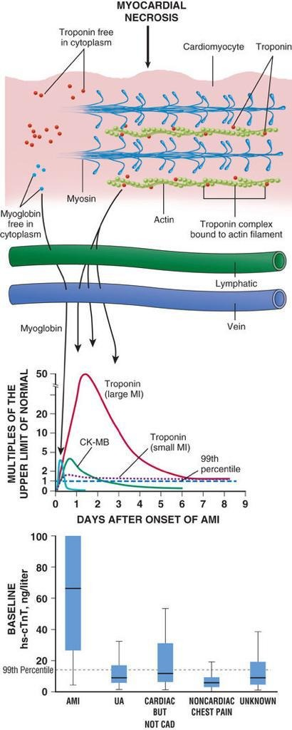

Slide 53
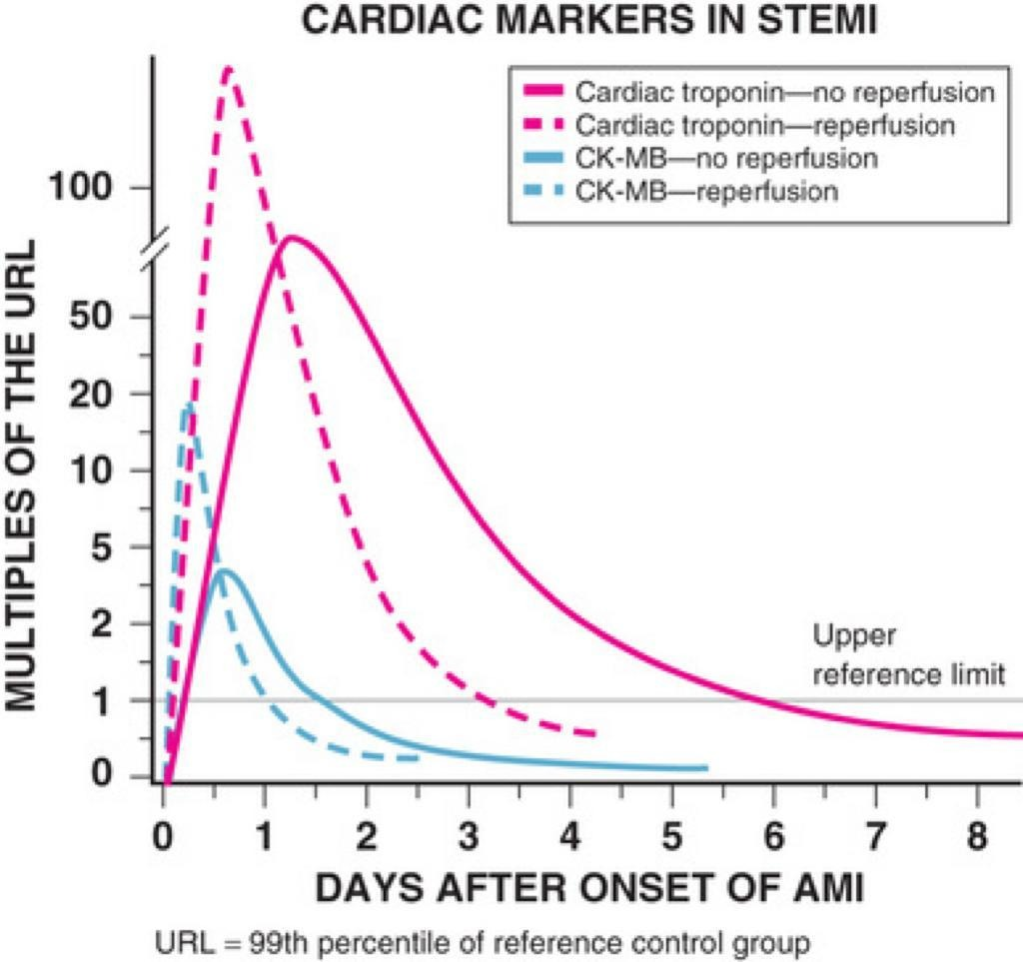

Slide 54
CPK-MB Isoenzyme
If a cardiac-specific troponin assay is not available, CK-MB measured with a mass assay is the best alternative.
Other tissues can contain small quantities of CK-MB, including the small intestine, tongue, diaphragm, uterus, and prostate.
Strenuous exercise, particularly in trained long-distance runners or professional athletes, can elevate both total CK and CK-MB.
The diagnosis of MI requires a maximal concentration of CK-MB exceeding the 99th percentile of values for sex-specific reference levels on two successive samples in a rise-and-fall pattern.
CK-MB may rise in circumstances involving severe skeletal muscle injury.

Slide 55
Recommendations for Measurement of Circulating MarkersAll
Allpatients with suspected MI should undergo measurement of cardiac-specific troponin as soon as possible at the initial encounter.
Use of conventional troponin assays permit the routine diagnosis of MI by obtaining measurements at initial evaluation and then 3 to 6 hours later .
The use of high-sensitivity assays can reduce the interval between testing to 1 to 2 hours in patients without diagnostic ECG changes. Emerging data suggest that an initial hsTn value below the limit of detection may provide a sufficiently high sensitivity and negative predictive value to enable discharge. Later testing is required only when uncertainty exists regarding the onset of pain or when stuttering symptoms occur. Testing beyond 2 hours from hospital arrival should also be considered for patients who arrive very early (<2 hours) after symptom onset.

Slide 56
Serum Lipids
During the first 24 to 48 hours after admission, total cholesterol HDL cholesterol remain at or near baseline values, but they generally fall after that.
The fall in HDL cholesterol after STEMI is greater than the fall in total cholesterol.
All patients with STEMI admitted within 24 hours of symptom onset should have a lipid profile.
Further measurements 4 to 8 weeks after MI provide more informative determination of serum lipid concentrations.

Slide 57
Hematologic Findings
WBC :
Increases usually within 2 hours after the onset of chest pain,
reaches a peak 2 to 4 days after infarction, and
returns to normal in 1 week;
the peak leukocyte count generally ranges between 12 and 15 × 103/mL but occasionally rises to as high as 20 × 103/mL in patients with large STEMI.
Frequently, there is an increase in the percentage of PMNand a left shift of the differential count.
In epidemiologic studies, higher WBC counts at initial evaluation in patients with an ACS are associated with an increased risk for adverse clinical outcomes.

Slide 58
ESR:
Is usually normal the first couple days after infarction.
It then rises to a peak on the fourth or fifth day
May remain elevated for several weeks.
The increase in the ESR does not correlate well with the size of the infarction or with prognosis.

Slide 59
Hematocrit:
Often increases during the first few days after infarction as a consequence of hemoconcentration.
The hemoglobin value at initial evaluation of a patient with STEMI is strongly associated with the risk of recurrent major cardiovascular events following a J-shaped relationship.
Cardiovascular mortality increases progressively as the initial hemoglobin value falls below 14 to 15 g/dL; conversely, it also rises as the hemoglobin level increases above 17 g/dL.
The increased risk from anemia is probably related to diminished tissue delivery of oxygen, whereas the increased risk with polycythemia may be relates to an increase in blood viscosity.

Slide 60
Electrocardiography
The ECG remains the most important diagnostic test in the evaluation of patients with suspected ischemic symptoms.
Established criteria aid the diagnosis of STEMI in LBBB (Sgarbossa criteria).
Evidence of RBBB in setting of acute MI also portends a similar poor prognosis, and should prompt consideration of urgent catheterization in setting of persistent ischemic settings and RBBB.
Patients with chest pain and ECG changes consistent with STEMI must be considered for immediate reperfusion.
ST-segment elevations in aVR, reflecting the basal intraventricular septum, can be observed in up to 30% of STEMIs and identifies patients with a higher likelihood of left main coronary artery or multivessel disease and worse outcomes.

Slide 61
Prehospital Management
[19:02, 1/10/2020] Mahsa: Given the progressive loss of functioning myocytes with persistent occlusion of the infarct-related artery in STEMI (see Chapter 58), initial management aims to restore blood flow to the infarct zone as rapidly as possible. Primary PCI is generally the preferred option[19:04, 1/10/2020] Mahsa: failure to deliver any form of reperfusion therapy in approximately 15% of patients

Slide 62
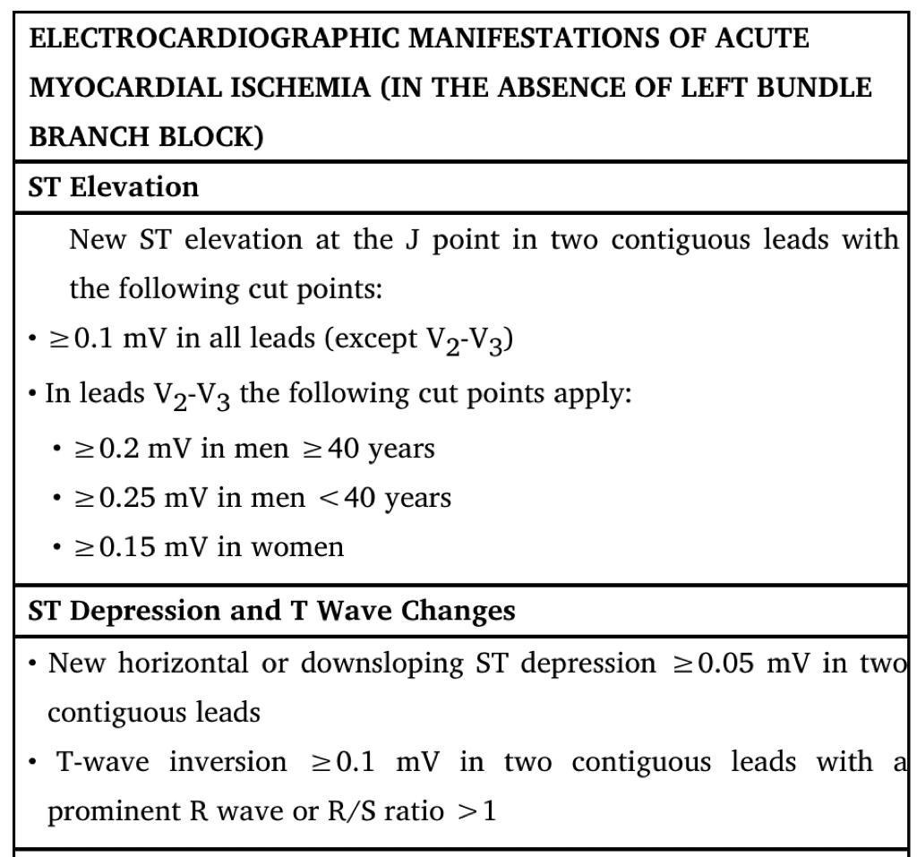

Slide 63
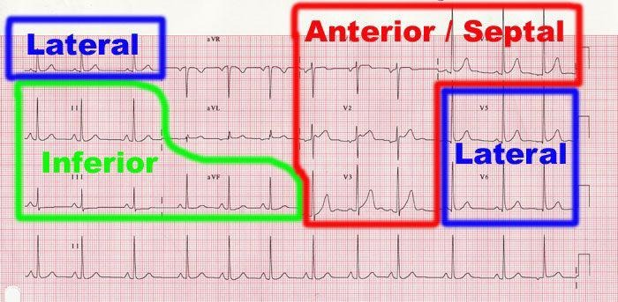

Slide 64
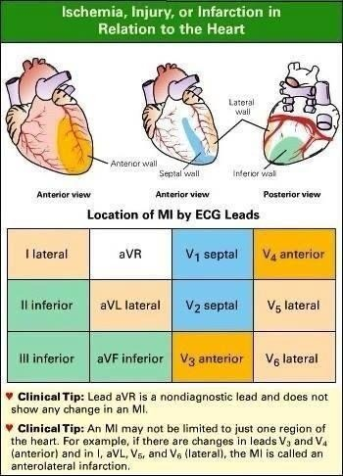

Slide 65
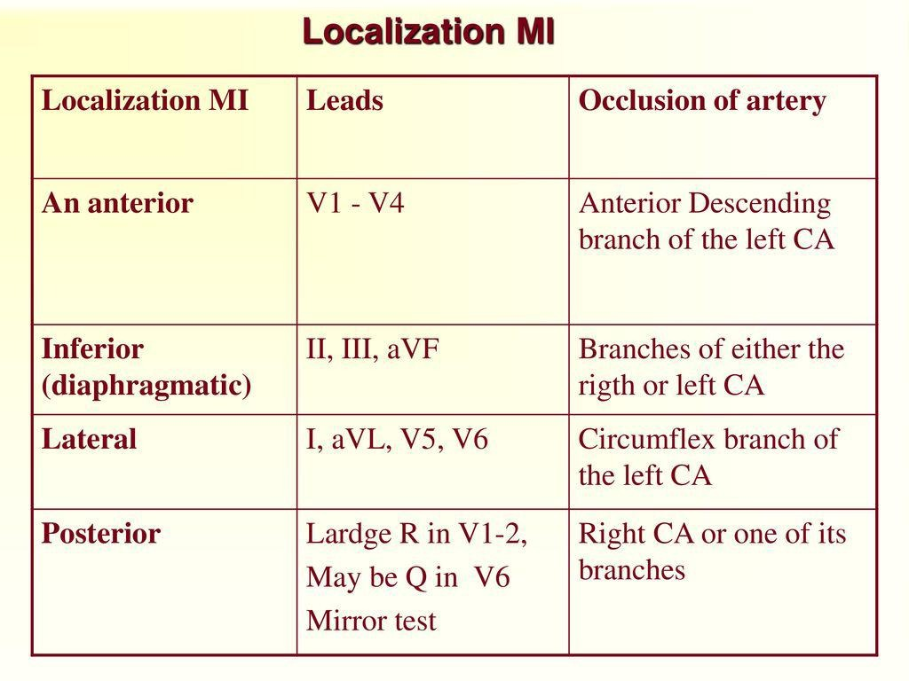

Slide 66
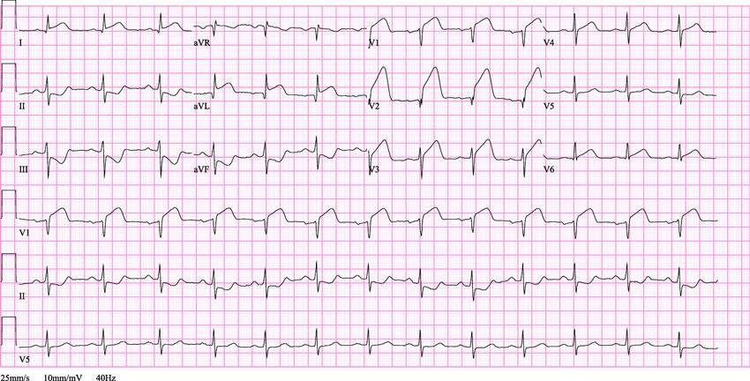

Slide 67
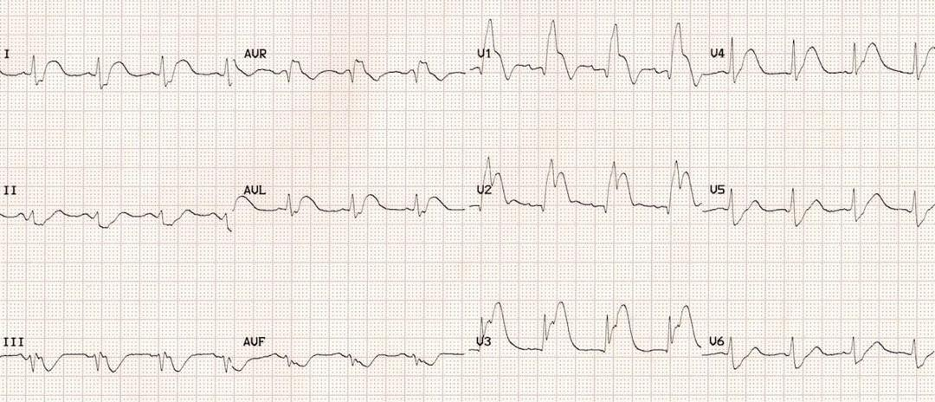

Slide 68
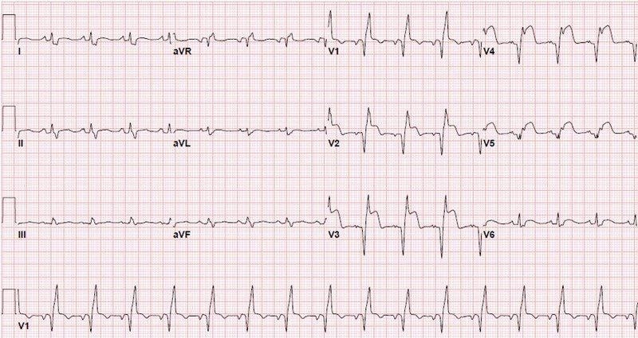

Slide 69
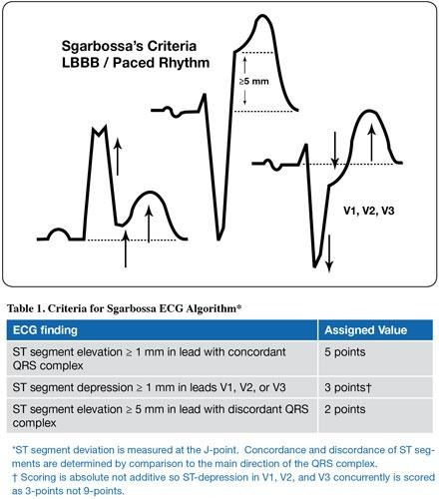

Slide 70
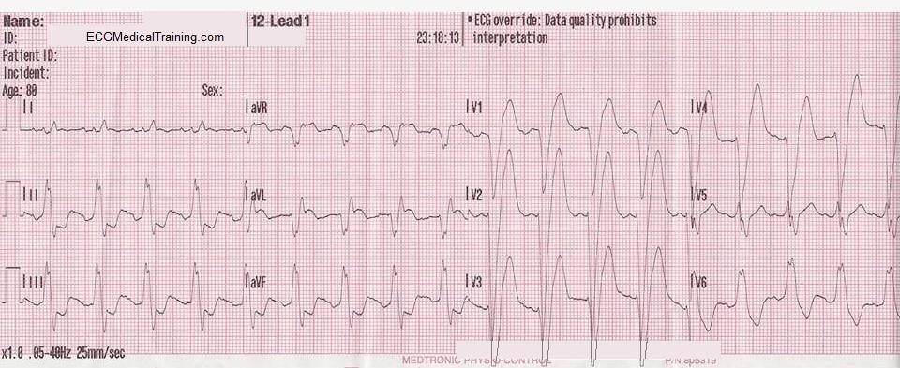

Slide 71
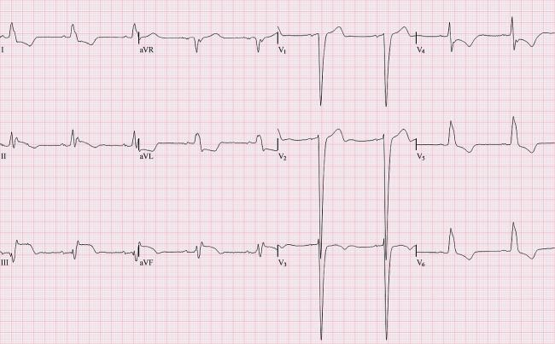

Slide 72
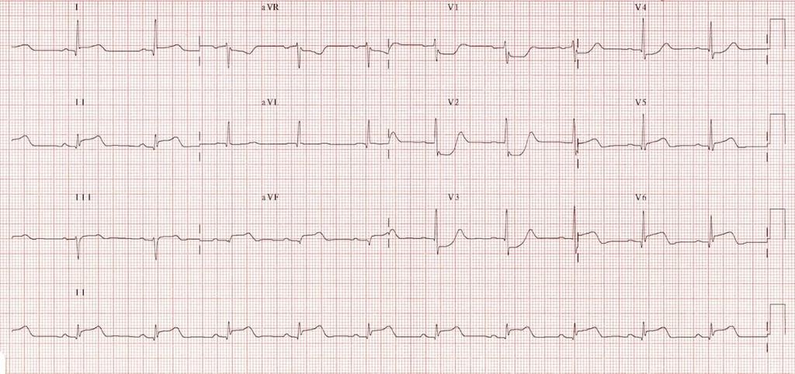

Slide 73
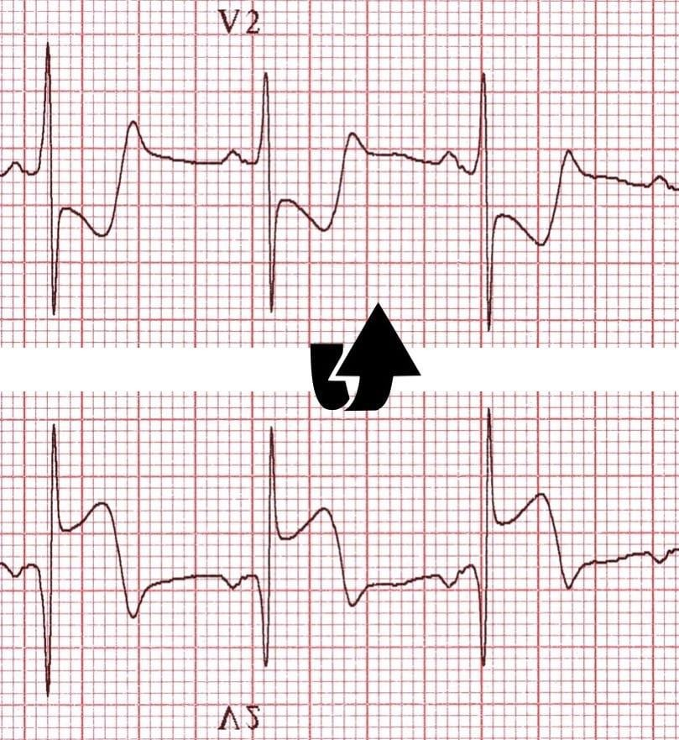

Slide 74
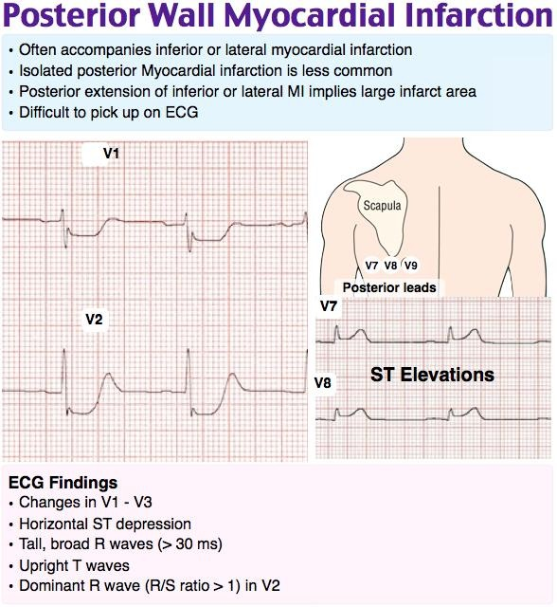

Slide 75
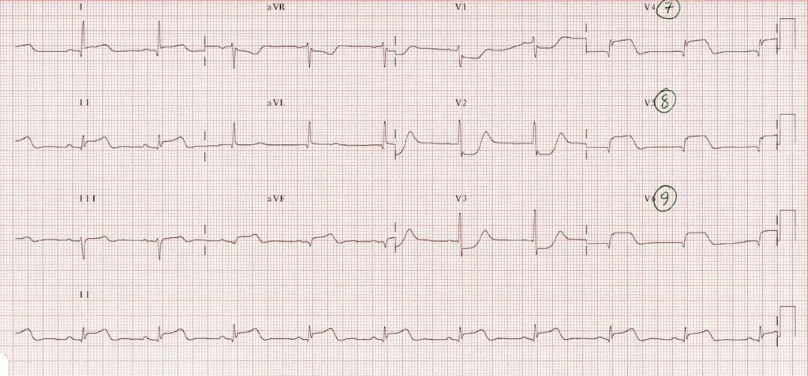

Slide 76
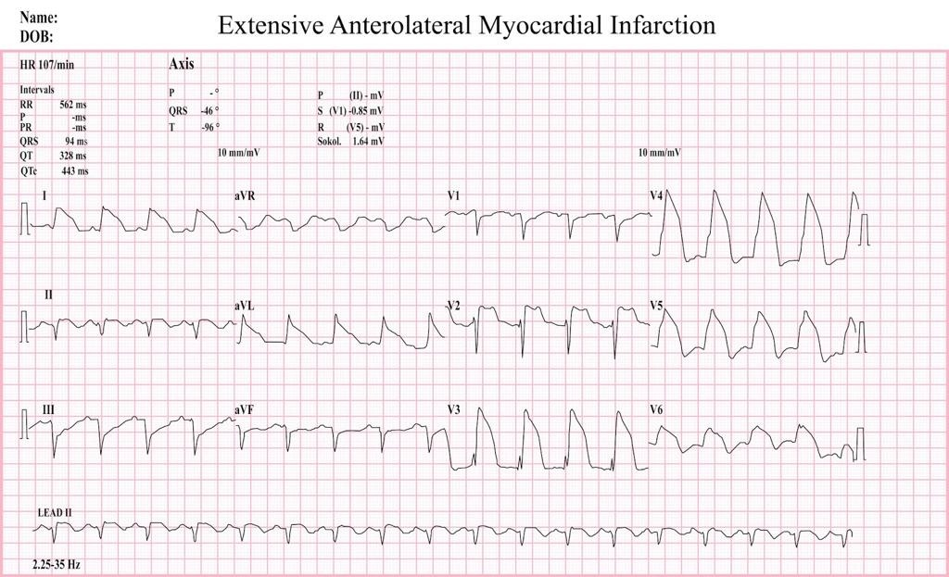

Slide 78
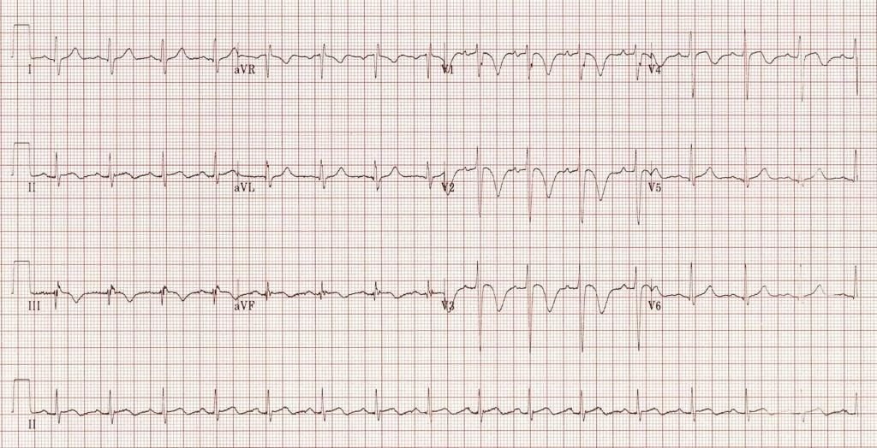
LAD Pattern (Wellen’s Pattern)

Slide 79
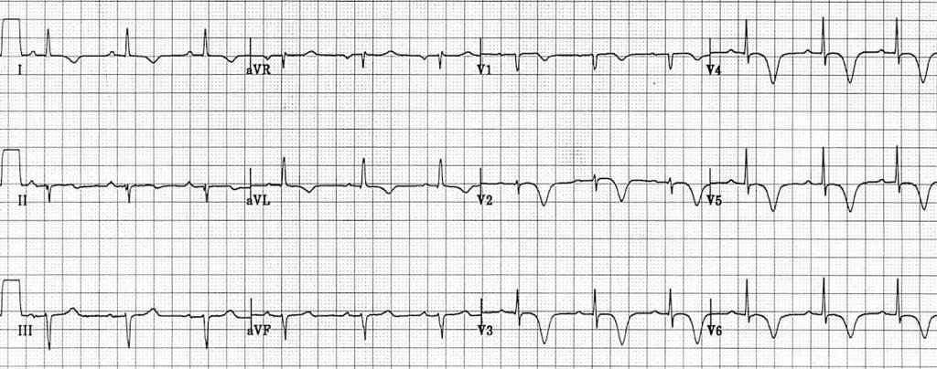

Slide 80
LAD Pattern (Wellen’s Pattern)
Some patients with ischemic chest pain present with deep "coronary" T wave inversions in multiple precordial leads (eg, V1 to V4) with or without cardiac enzyme elevations and with minimal or no ST elevations.
This pattern, sometimes called the Wellens' pattern or LAD-T wave inversion pattern, is typically caused by a tight stenosis in the LAD coronary artery system.
The natural history of this pattern is unfavorable, with a high incidence of recurrent symptoms and myocardial infarction.

Slide 81
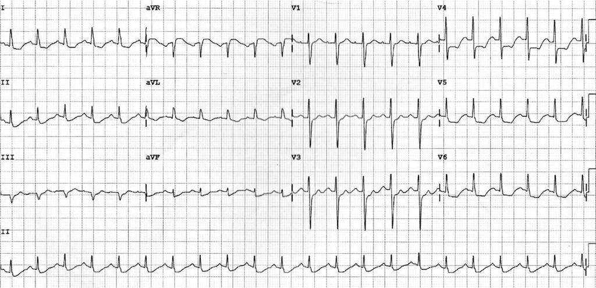

Slide 82
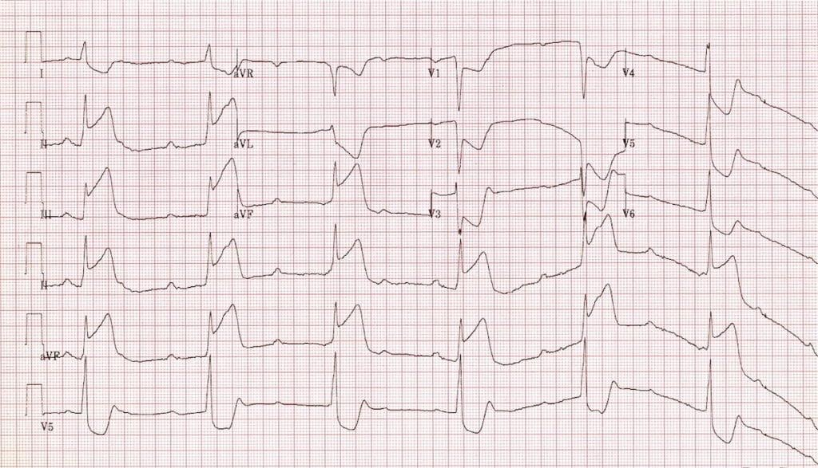

Slide 83
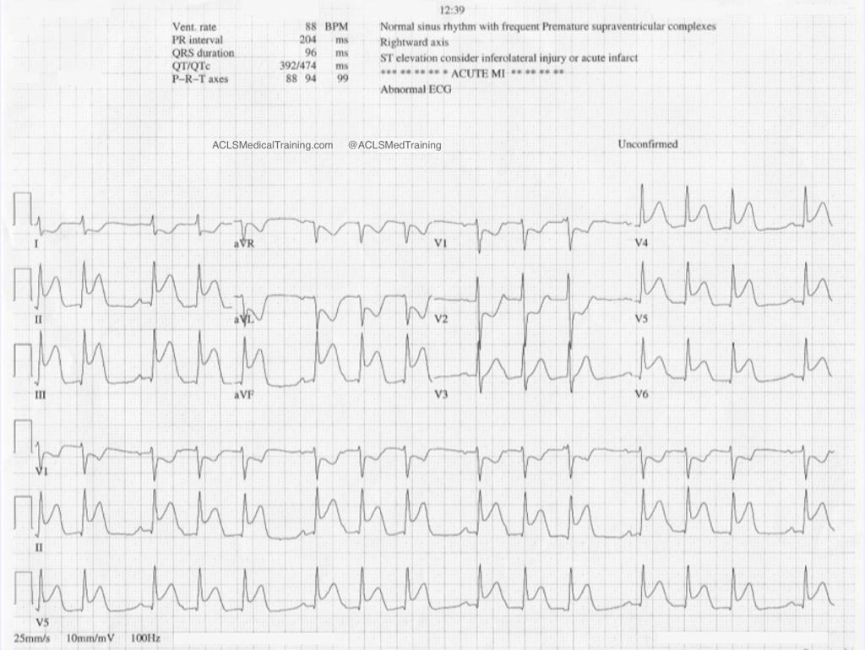

Slide 84
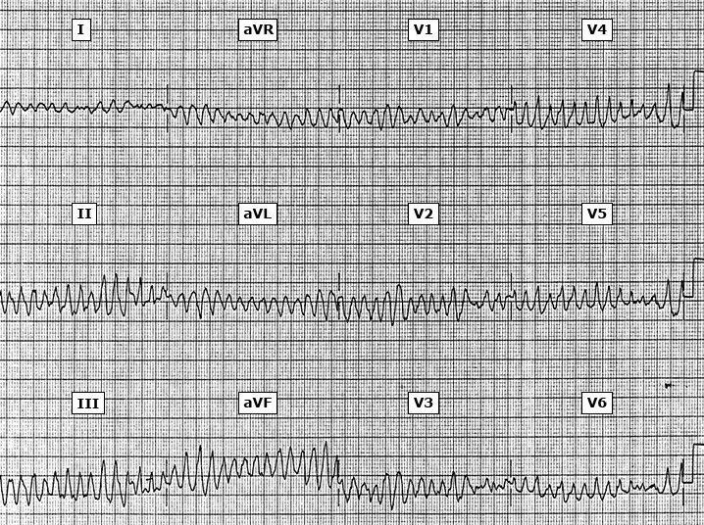

Slide 85
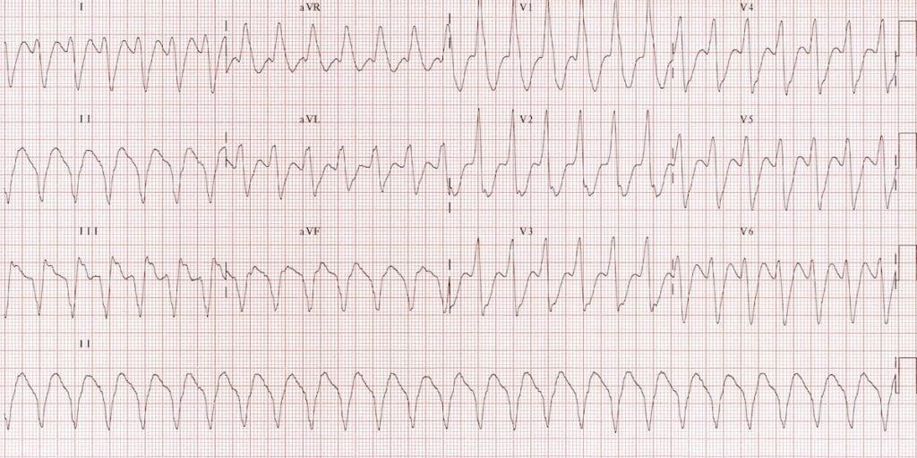

Slide 86
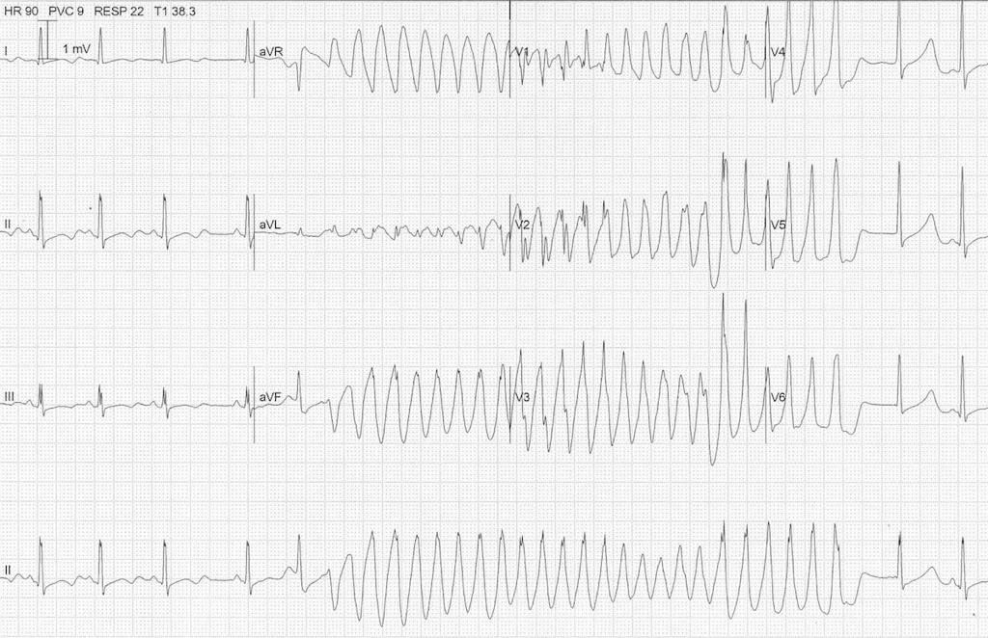

Slide 87
Given the progressive loss of functioning myocytes with persistent occlusion of the infarct-related artery in STEMI, initial management aims to restore blood flow to the infarct zone as rapidly as possible.
Primary PCI is generally the preferred option (If not possible , fibrinolytic).
Failure to deliver any form of reperfusion therapy in approximately 15% of patients with STEMI.

Slide 88
Most deaths associated with STEMI occur within the first hour of its onset and usually result from ventricular fibrillation (VF). Therefore, immediate implementation of resuscitative efforts and rapid transportation of the patient to a hospital have prime importance.

Slide 89
Patient-related factors that correlate with a longer delay until deciding to seek medical attention include:
older age;
female sex;
black race;
low socioeconomic or uninsured status;
history of angina, diabetes, or both;
consulting a spouse or other relative;
consulting a physician

Slide 90
Health care professionals should heighten the level of awareness of for STEMI (e.g., those with hypertension, diabetes, history of angina pectoris).
They should use each patient encounter as a “teachable moment” to review and reinforce with patients and their families the need to seek urgent medical attention for a pattern of symptoms that includes chest discomfort, extreme fatigue, and dyspnea.
Patients should also be instructed in the proper use of sublingual nitroglycerin and to call emergency services if the ischemic-type discomfort persists for more than 5 minutes.

Slide 91
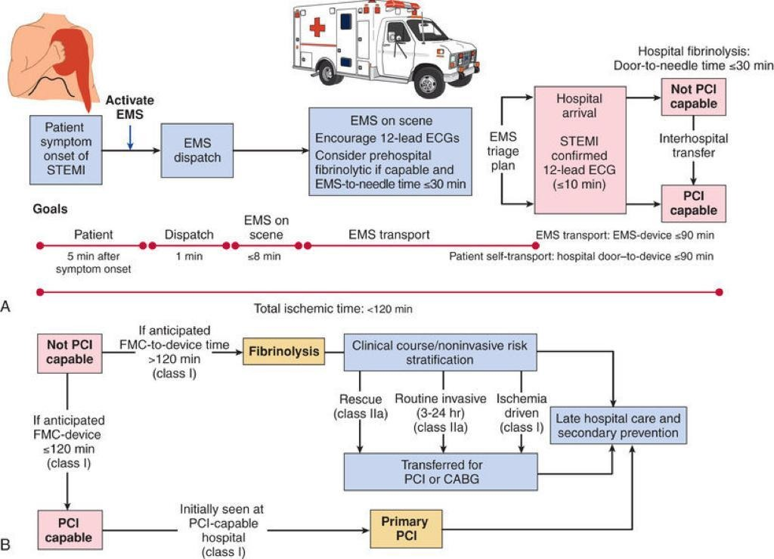

Slide 92
Because the 12-lead ECG is at the center of the decision pathway for initiation of reperfusion therapy, it should be obtained promptly (≤10 minutes after hospital arrival) in patients with suspected ischemic symptoms.
Because lethal arrhythmias can occur suddenly in patients with STEMI, all patients should have bedside monitoring of the ECG and intravenous (IV) access.

Slide 93
Critical factors that weigh into selection of a reperfusion strategy include:
- The time elapsed since the onset of symptoms
- The risk associated with STEMI
- The risk related to administering a fibrinolytic,
- The time required to initiate an invasive strategy

Slide 94
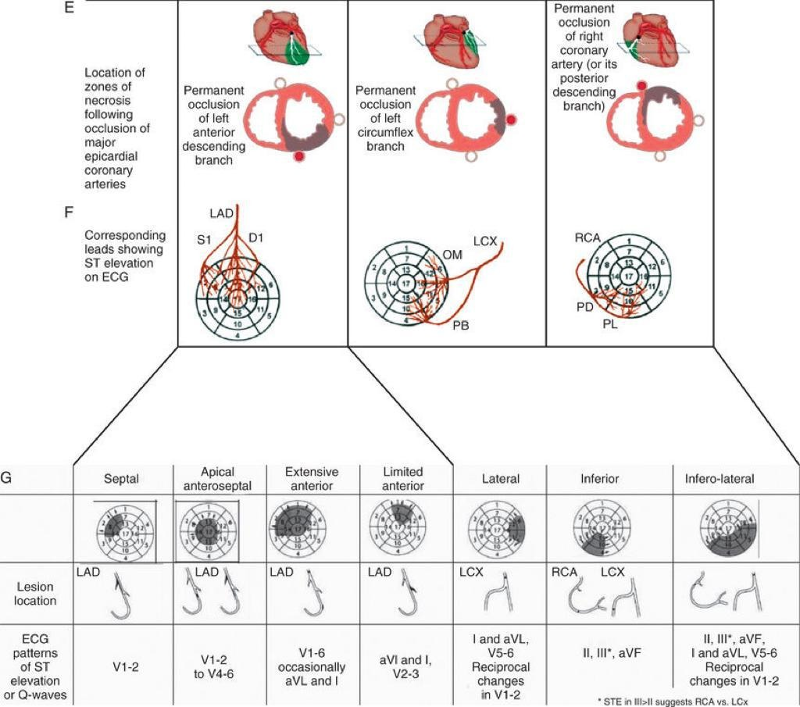

Slide 95
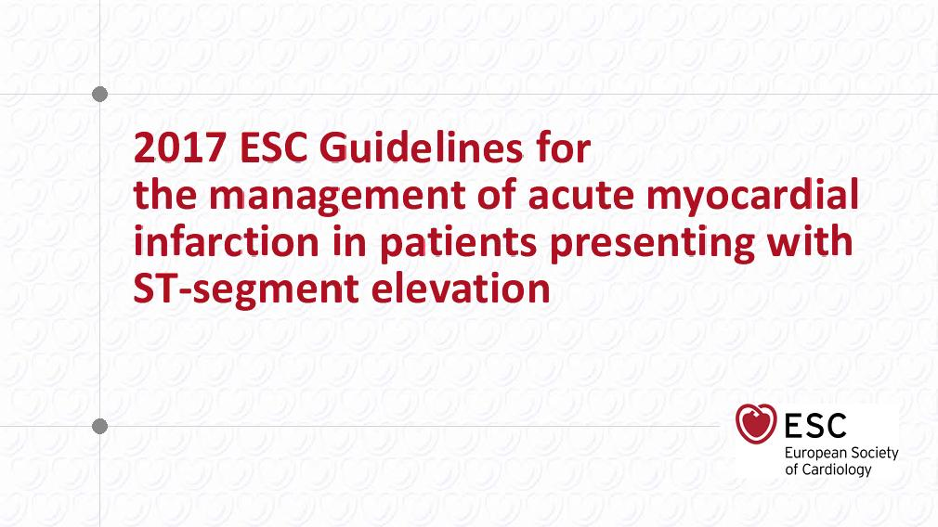

Slide 96
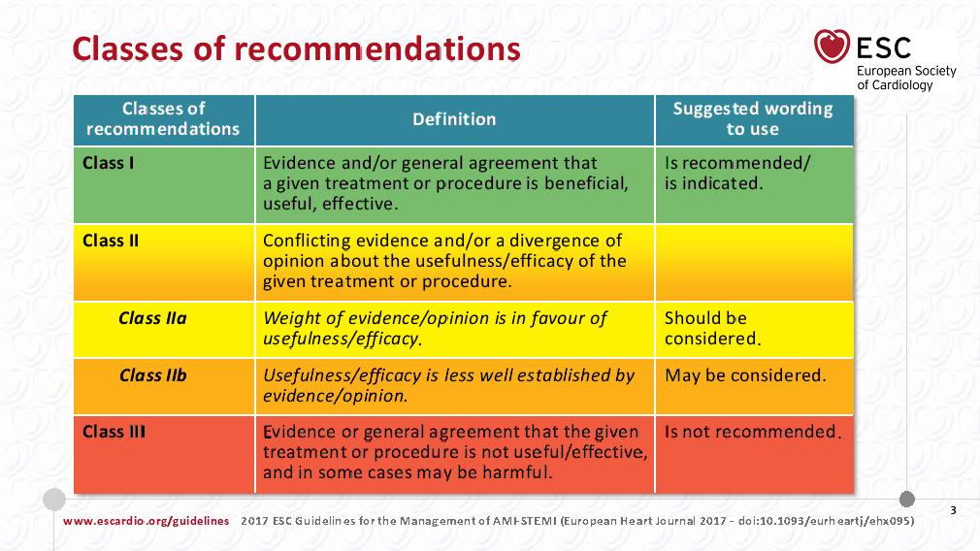

Slide 97
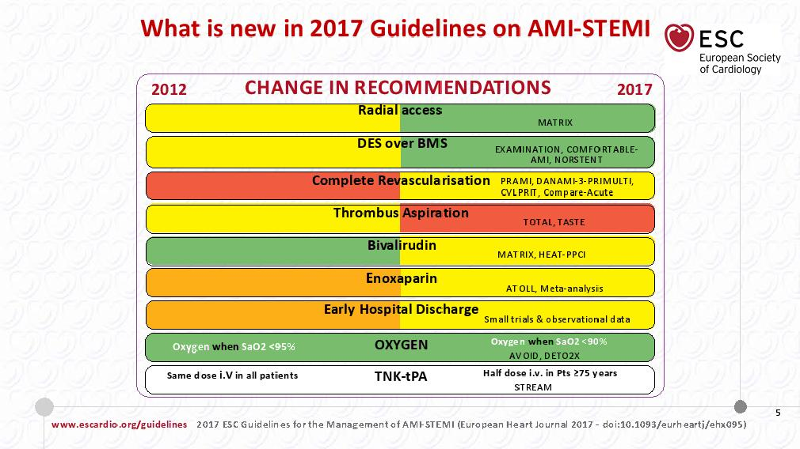

Slide 98
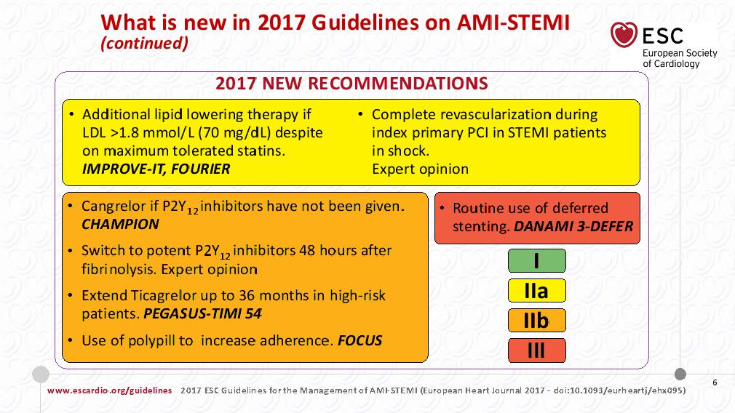

Slide 99
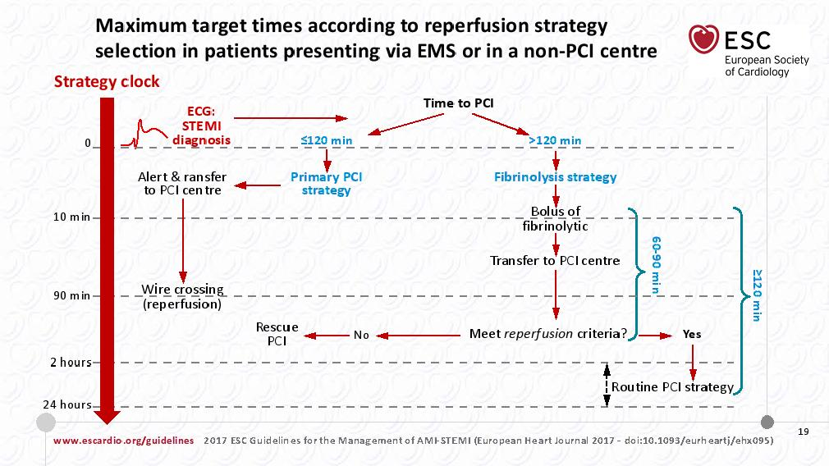

Slide 100
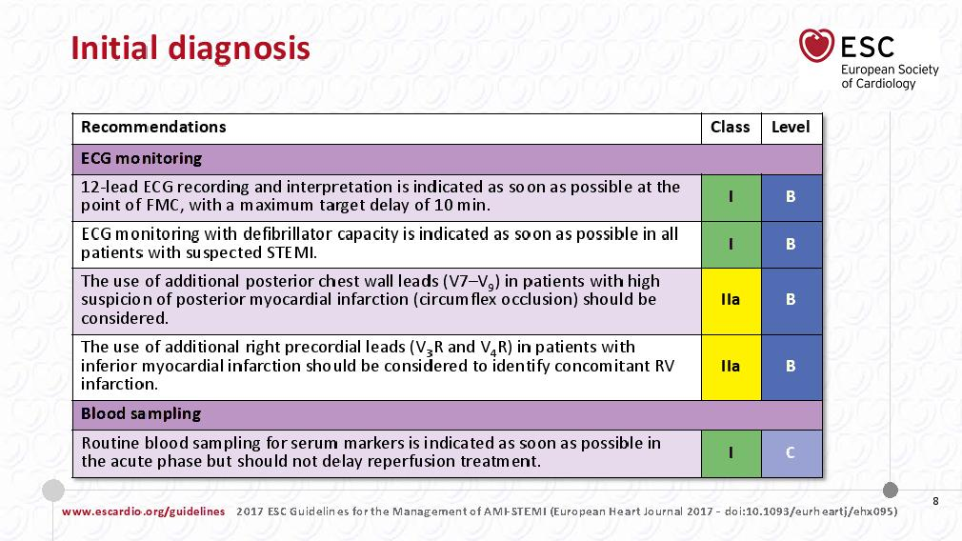

Slide 102
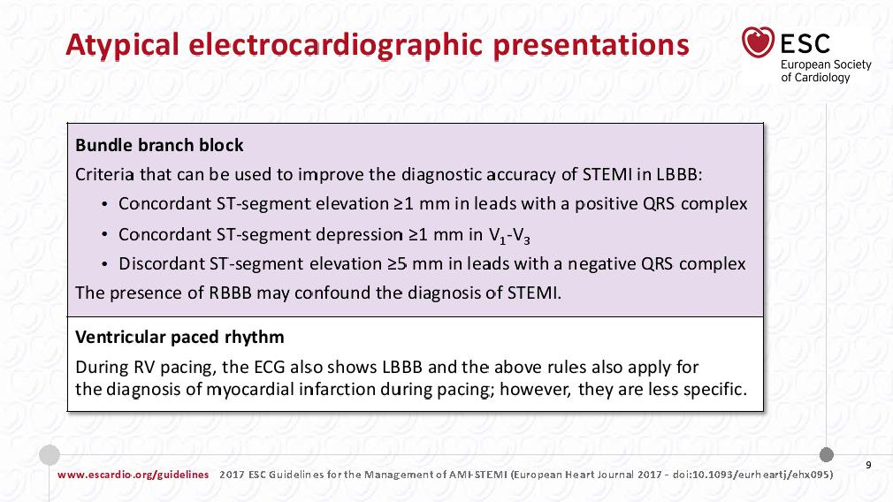

Slide 103
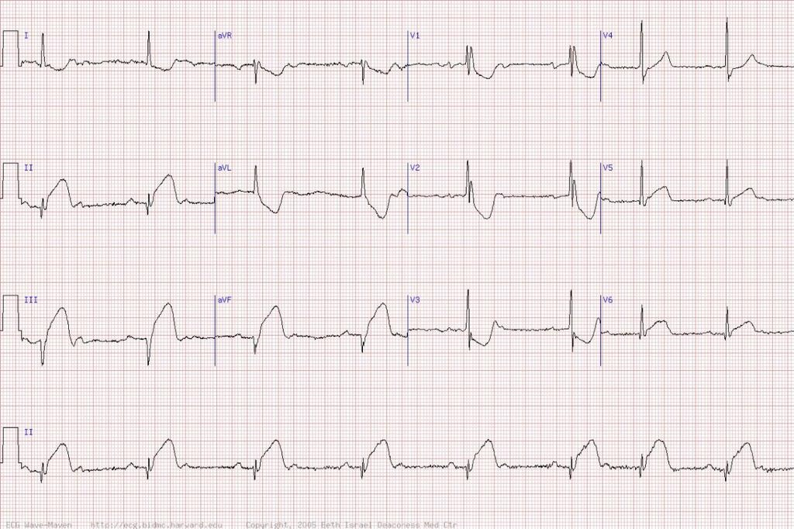

Slide 104
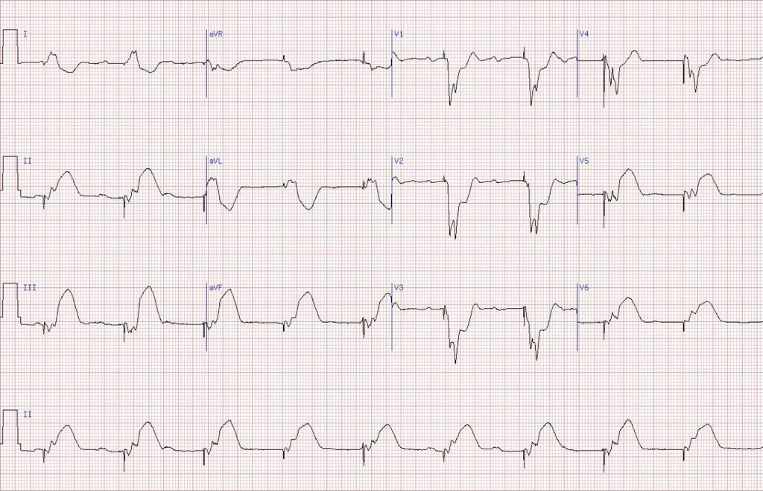

Slide 105
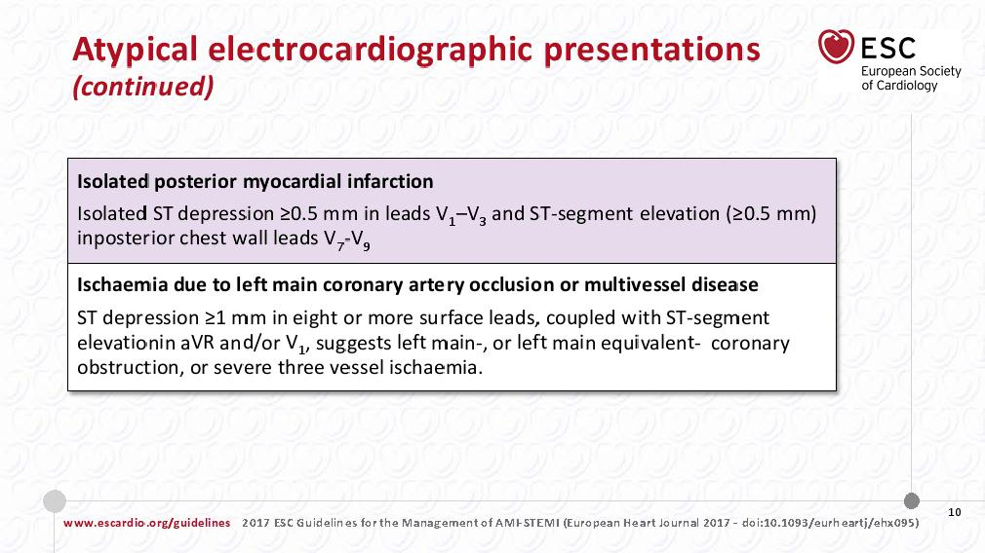

Slide 106
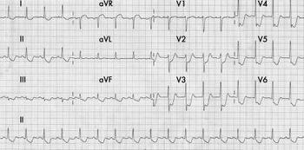
Left Main Pattern

Slide 107
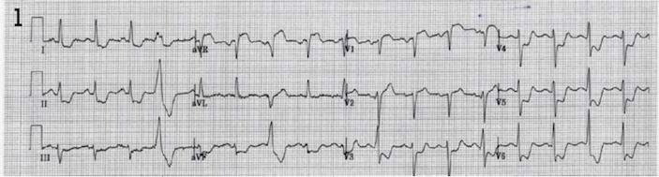
Left Main Pattern

Slide 108
Left Main Pattern

Slide 109
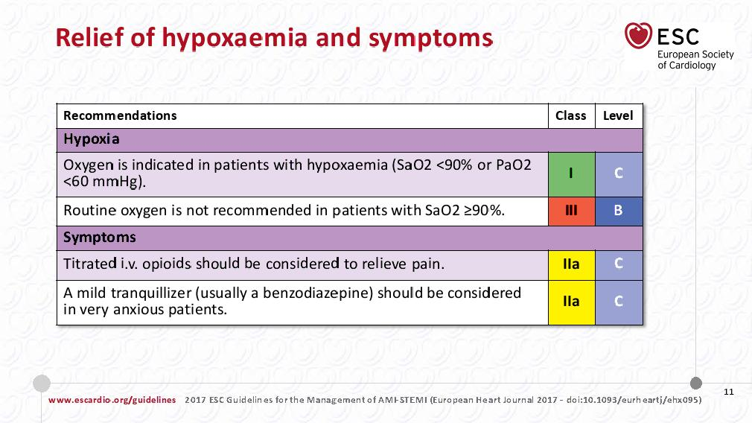

Slide 110
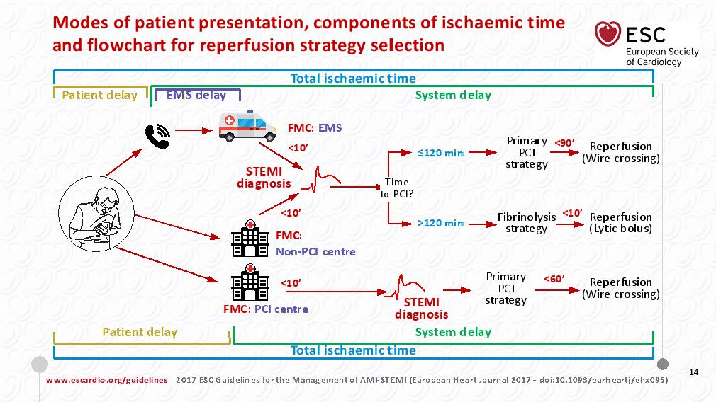

Slide 111
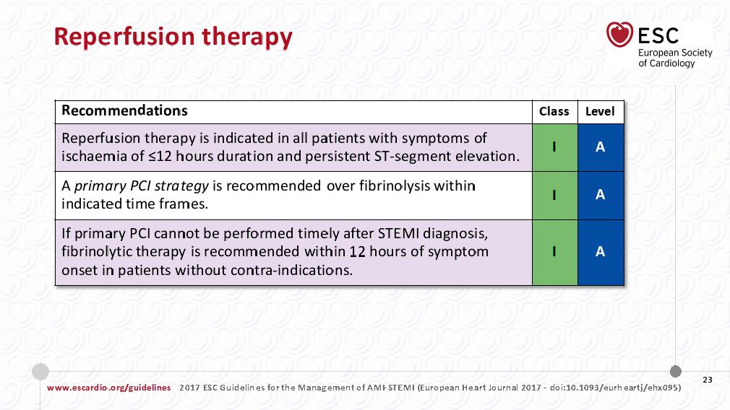

Slide 112
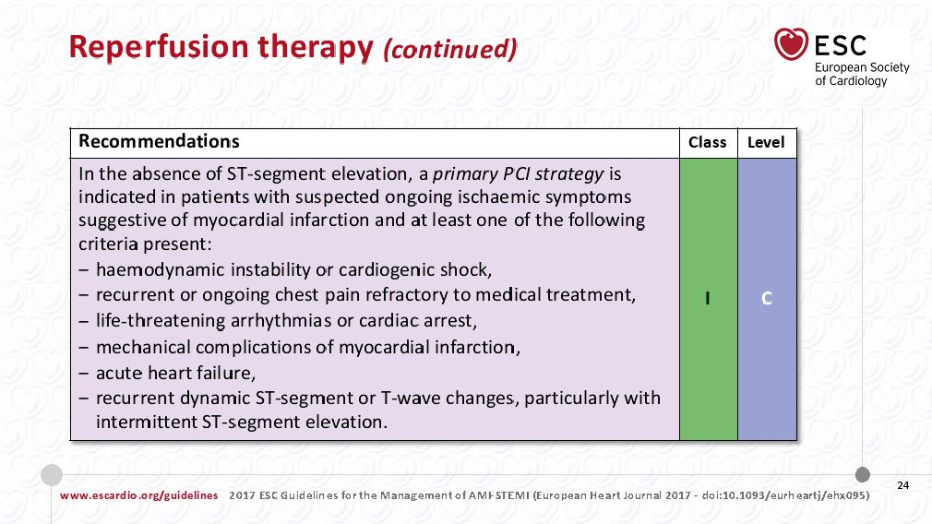

Slide 113
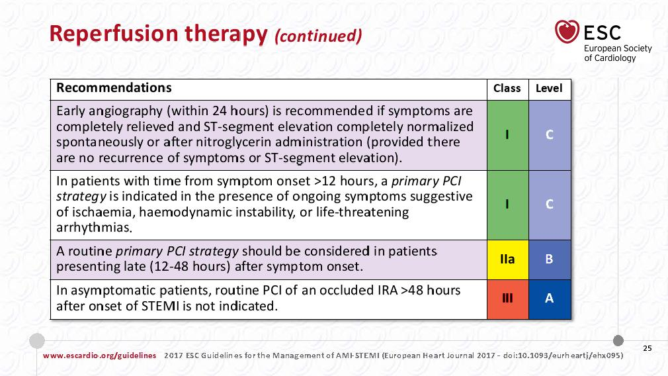

Slide 114
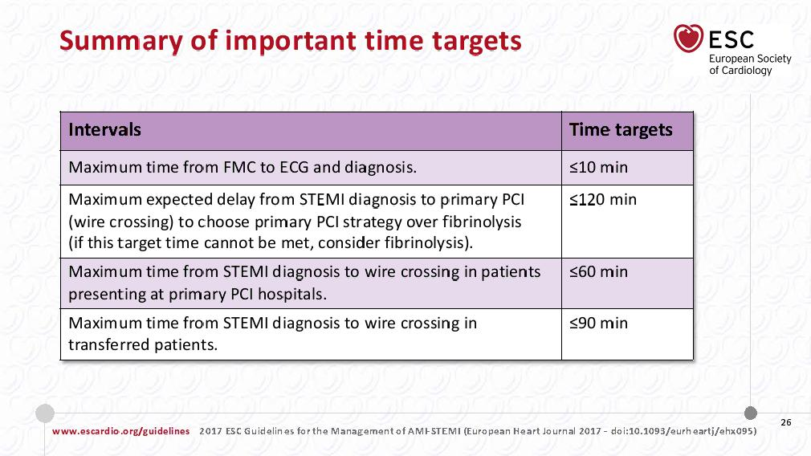

Slide 115


Slide 116


Slide 117


Slide 118


Slide 119


Slide 120


Slide 121


Slide 122


Slide 123


Slide 124


Slide 125


Slide 126


Slide 127


Slide 128


Slide 129


Slide 130


Slide 131


Slide 132


Slide 133


Slide 134


Slide 135


Slide 136


Slide 137


Slide 138


Slide 139


Slide 140


Slide 141


Slide 142
Cardiogenic Shock
Congestion and inadequate tissue or end-organ perfusion secondary to cardiac insufficiency characterize cardiogenic shock.
This reduction in perfusion decreases O2 and nutrient delivery to tissues, which if severe or protracted, can lead to multiorgan dysfunction and death.
Cardiogenic shock complicating MI results from:
LV dysfunction (approximately 80%);
Mechanical defect (e.g., VSD, papillary muscle rupture)
Predominant RV infarction

Slide 143
Patients with cardiogenic shock complicating STEMI are more likely to be older; to have a history of diabetes mellitus, previous MI, or HF; and to have sustained an anterior infarction at the time of development of shock.
In the past, cardiogenic shock occurred in up to 20% of patients with STEMI, but estimates from recent large trials and observational data bases report an incidence rate of 5% to 8%.
When shock occurs, the prognosis remains poor, with in-hospital mortality rates of 40% to 60%, and few interventions, with the exception of prompt coronary revascularization, conclusively provide benefit.

Slide 144
At autopsy, more than two thirds (2/3) of patients with cardiogenic shock demonstrate multivessel coronary disease, usually including the left anterior descending coronary artery (LAD).
Almost all patients with cardiogenic shock exhibit thrombotic occlusion of the artery supplying the major region of recent infarction, with loss of 40% or more of LV mass.1

Slide 145


Slide 146


Slide 147
Arrhythmias

Slide 148
Ventricular Premature Depolarizations (PVC)
Before the widespread use of reperfusion therapy, aspirin, and beta blockers for the management of STEMI, (1) frequent ventricular premature complexes (VPCs) (>5/min), (2) VPCs with a multiform configuration, (3) early coupling (“R-on-T” phenomenon), and (4) repetitive patterns in the form of couplets or salvoes were thought to presage VF.
The previous practice of prophylactic suppression of ventricular premature beats with antiarrhythmic drugs is not indicated and may actually increase the risk for fatal bradycardic and asystolic events.

Slide 149
PVC
We therefore pursue a conservative course in patients with STEMI with VPCs and do not routinely prescribe antiarrhythmic drugs, other than beta blockers, but instead correct any recurrent ischemia or electrolyte or metabolic disturbances.
When VPCs accompany sinus tachycardia at the inception of an infarction, augmented sympathoadrenal stimulation often contributes and can be treated by beta blockers. In fact, early administration of an IV beta blocker effectively reduces the incidence of VF in evolving MI.

Slide 150
Accelerated Idioventricular Rhythm
Typically occurs during the first 2 days,
with about equal frequency in anterior and inferior infarctions.
Most episodes are brief.
Often follows when successful reperfusion has been established with fibrinolytic therapy.
However, the frequent occurrence of this rhythm in patients without reperfusion limits its reliability as a marker of the restoration of patency of the infarct-related coronary artery.
In contrast to rapid VT, accelerated idioventricular rhythm is thought not to affect prognosis, and we do not routinely treat accelerated idioventricular rhythms.

Slide 151


Slide 152
Ventricular Tachycardia and Ventricular Fibrillation
A leading hypothesis for a major mechanism of ventricular arrhythmias in the acute phase of coronary occlusion is reentry caused by inhomogeneity of the electrical characteristics of ischemic myocardium.
The cellular electrophysiologic mechanisms for reperfusion arrhythmias appear to include washout of various ions such as lactate and potassium and toxic substances that have accumulated in the ischemic zone.
VT or VF occurring late in the course of STEMI is more common in patients with transmural infarction and LV dysfunction and is more frequently associated with hemodynamic deterioration.

Slide 153
VT and VF Prophylaxis
Because hypokalemia can increase the risk for development of VT, low serum potassium levels require prompt identification and treatment after admission for STEMI.
Despite the lack of a consistent relationship between hypomagnesemia and ventricular arrhythmias, magnesium deficits may still link to risk because patients with STEMI have reduced intracellular magnesium levels not adequately reflected by serum measurements.
As noted earlier, magnesium should be repleted to achieve a serum level of 2 mEq/L.
Early beta-blocker use has reduced VF and can be instituted in patients who lack a contraindication.
Lidocaine prophylaxis to prevent primary VF is no longer advised.

Slide 154
ManagementTreatment of unstable VT or VF
consists of electrical cardioversion implemented as rapidly as possible.
IV administration of amiodarone can also facilitate management of unstable ventricular arrhythmias or prevention of refractory recurrent episodes.
After reversion to sinus rhythm, every effort should be made to correct any underlying abnormalities, such as hypoxia, hypotension, acid-base or electrolyte disturbances, or digitalis excess.
Urgent revascularization is warranted if ventricular arrhythmias are ongoing and caused by ischemia.
In patients with sustained VT or VF at a time after successful reperfusion, we generally continue antiarrhythmic therapy, most often amiodarone, until a defibrillator is placed.

Slide 155
Prognosis of VT/VF
Among patients who underwent fibrinolytic therapy, approximately 10% experienced VT/VF.
In patients treated with primary PCI, sustained VT/VF developed in 5.7%.
Patients with VT/VF had worse clinical outcomes than those without VT/VF.
Additionally, mortality rates were higher in those with late versus early VT/VF; specifically, when compared with patients without VT/VF, the adjusted risk of mortality at 90 days increased twofold or sixfold in patients with early or late VT/VF, respectively.

Slide 156
In patients in whom sustained VT/VF develops later in the course after STEMI (e.g., >48 hours) without evidence of a reversible cause, ICD therapy for secondary prevention should be considered before discharge.
This situation differs from that in patients with VT/VF before reperfusion therapy, in whom antiarrhythmic therapy other than a beta blocker is not indicated.

Slide 157
Sinus Bradycardia
Frequently occurs during the early phases of STEMI,
Particularly in patients with inferior and posterior infarctions.
The increased vagal tone that produces sinus bradycardia during the early phase of STEMI may actually be beneficial.
Isolated sinus bradycardia, unaccompanied by hypotension or ventricular ectopy, should be observed rather than treated.
In the first 4 to 6 hours after infarction, if the sinus rate is extremely low (<40 to 50 beats/min) and associated with hypotension, IV atropine in doses of 0.3 to 0.6 mg every 3 to 10 minutes (with total dose not exceeding 3 mg) can be administered to bring the heart rate up to approximately 60 beats/min.

Slide 158


Slide 159
Approach to the Patient with Chest Pain
Acute chest pain is one of the most common reasons for seeking care in the emergency department (ED) : approximately 10%
After diagnostic evaluation only 10% to 15% of patients with acute chest pain actually have ACS.
The diagnosis of ACS is missed in approximately 2% of patients

Slide 160
Common Causes of acute Chest Pain
Cardiac
Vascular
Pulmonary
Gastrointestinal
Musculoskeletal
Infectious
Psychological

Slide 161
Cardiac Causes of Acute Chest Pain
Angina (Stable Coronary syndrome)
Rest or Unstable Angina
Acute MI
Pericarditis

Slide 162
Angina Pectoris
Classic angina pectoris is described as a pressure, heaviness, tightness, or constriction in the center or left of the chest that is precipitated by exertion and relieved by rest. It is generally not described as pain (sharp or dull), or needles and pins.
Quality
Location and radiation
Provoking factors
Timing, Duration and relief

Slide 163
Typical qualities of anginal pain (Quality)
Angina is usually characterized more as a discomfort rather than pain.
Terms frequently used by patients include squeezing, tightness, pressure, constriction, strangling, burning, heart burn, fullness in the chest, band-like sensation, knot in the center of the chest, lump in throat, ache, heavy weight on chest (elephant sitting on chest), like a bra too tight, and toothache (when there is radiation to the lower jaw) [17]. In some cases, the patient cannot qualify the nature of the discomfort, but places his or her fist in the center of the chest, known as the "Levine sign.“
It is generally not described as sharp, dull-aching, knife-like, stabbing, or pins and needles-like. In a report of patients presenting to the emergency department, "sharp" or "stabbing" pain was a low risk description, particularly when the pain was pleuritic or positional, was fully reproducible by palpation, and the patient had no history of angina or myocardial infarction .

Slide 164
The following additional characteristics are typically seen:
Angina is typically gradual in onset and offset, with the intensity of the discomfort increasing and decreasing over several minutes. In contrast, noncardiac pain is often of greatest intensity at its onset and often has an abrupt onset and offset.
Since angina is a referred discomfort, patients tend to have the same quality of chest discomfort with recurrent ischemic episodes. Generally, it is felt in the same location. The discomfort is generally the same prior to or with a myocardial infarction and is the same quality as prior to revascularization by either surgery (although the location may be different due to disruption of neural innervation of the heart) or percutaneous coronary intervention.
Angina is a constant discomfort that does not change with respiration or position. It is also not provoked or worsened with palpation of the chest wall.
However, the presence of a change in pain with respiration (or position) or pain elicited by palpation does not exclude angina as the cause.

Slide 165
Typical qualities of anginal pain (Location and Radiation)
Angina is a referred pain due to involvement of a neural reflex pathway via the thoracic and cervical nerves. As a result, it is not felt in a specific spot, but is usually a diffuse discomfort that may be difficult to localize.
The patient often indicates the entire chest when asked where the discomfort is felt.
Pain that localizes to one small area of the chest is more likely of chest wall or pleural origin rather than visceral.

Slide 166
Angina often radiates to other parts of the body, including the upper abdomen (epigastric), shoulders, arms (upper and forearm), wrist, fingers, neck and throat, lower jaw and teeth (but not upper jaw), and rarely to the back (specifically the interscapular region).
Radiation to both arms is a stronger predictor of acute myocardial infarction.
Isolated back pain is unusual in patients with angina. However, it may be seen with an aortic dissection that also involves the coronary arteries.

Slide 167
Typical qualities of anginal pain (Provoking Factors)
Angina is often elicited by activities and situations that increase myocardial oxygen demand, including physical activity, cold, emotional stress, sexual intercourse, meals, or lying down (which results in an increase in venous return and increase in wall stress).
Patients should be questioned about the use of cocaine or other recreational drugs, as they may trigger myocardial ischemia.
Postprandial pain is generally considered to be gastrointestinal in origin. However, it may also be anginal, especially in patients with severe ischemia (eg, left main or three vessel coronary disease).

Slide 168
Typical qualities of anginal pain (Timing)
Angina occurs more commonly in the morning due to a diurnal increase in sympathetic tone.
Enhanced sympathetic activity raises heart rate, blood pressure, vessel tone and resistance (resulting in a reduced vessel diameter that causes any fixed lesion to be more occlusive), and promotes platelet aggregation (resulting in the release of vasoactive substances, such as serotonin and thromboxane.

Slide 169
Typical qualities of anginal pain (Duration and relief)
Classic angina is often relieved with termination of the provoking factor.
Angina generally lasts for two to five minutes.
It is not a fleeting discomfort, which lasts only for a few seconds or less than a minute.
It generally does not last for 20 to 30 minutes, unless the patient is experiencing an acute coronary syndrome, especially myocardial infarction

Slide 170
Factors that reduce oxygen demand or increase oxygen supply will result in relief of angina. These include :
cessation of activity or termination of the provoking factor
use of nitroglycerin (which is a venodilator, reducing venous return, and a coronary artery vasodilator that increases coronary blood flow)
sitting up (which reduces venous return and preload).

Slide 171
Relief of chest discomfort with nitroglycerin is not specific for angina, since a similar response may be seen with esophageal spasm or other gastrointestinal problems as nitroglycerin also relaxes smooth muscle. In a review of 459 patients presenting to an emergency department with chest pain, the percentage of patients with relief of chest discomfort with nitroglycerin was similar among those with and without active coronary disease.

Slide 172
Atypical features
The following characteristics were found to be more typical of nonischemic chest discomfort:
●Pleuritic pain, sharp or knife-like pain related to respiratory movements or cough.
●Primary or sole location in the mid or lower abdominal region.
●Any discomfort localized with one finger.
●Any discomfort reproduced by movement or palpation.
●Constant pain lasting for days.
●Fleeting pains lasting for a few seconds or less.
●Pain radiating into the lower extremities or above the mandible.

Slide 173
Associated symptoms
The most common is shortness of breath or wheezing, which may reflect mild pulmonary congestion. Pulmonary congestion is due to an elevation in left ventricular end diastolic pressure related to failure of the myocardium to relax normally in diastole.
Other symptoms may include belching, nausea, indigestion, diaphoresis, dizziness, lightheadedness, clamminess, and fatigue. However, these symptoms may be seen with other etiologies for chest pain, especially gastrointestinal causes.

Slide 174
It is common for patients with diabetes mellitus, who often have autonomic (sympathetic) dysfunction, to experience "silent ischemia" or best termed "discomfortless ischemia". In this situation, they may experience the above symptoms associated with ischemia in the absence of the chest discomfort due to failure of transmission of neural impulses from the heart to the spinal cord.

Slide 175


